Slide 1
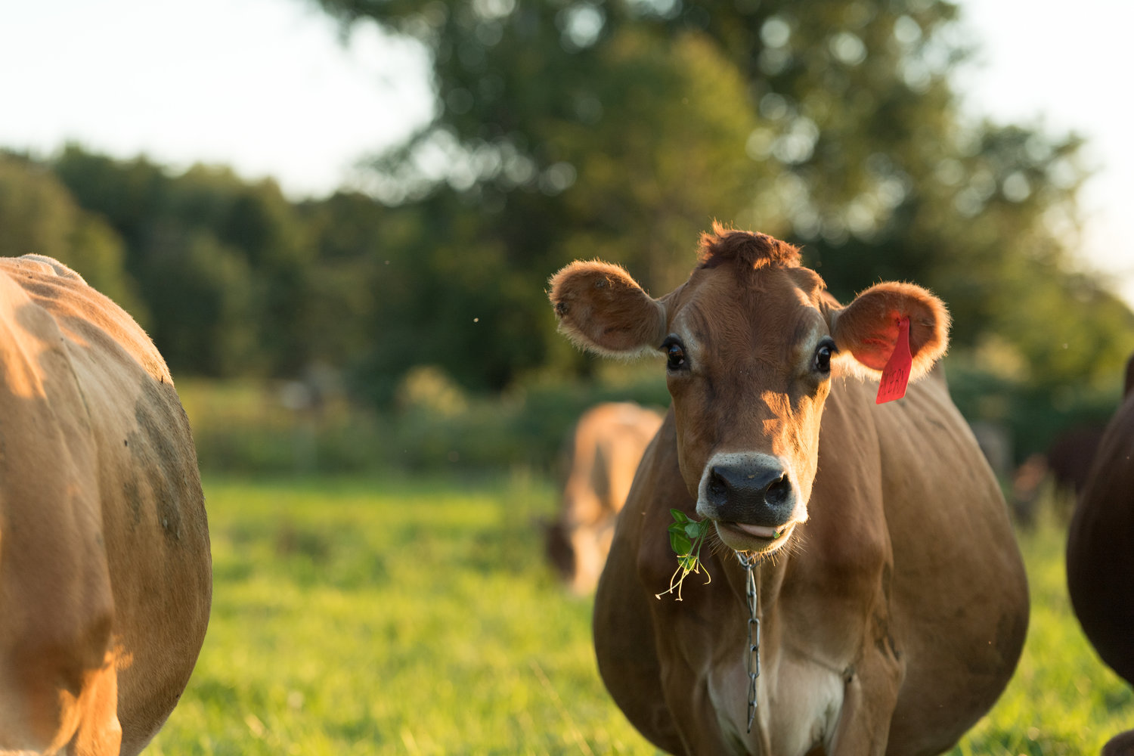
Photo: M. Webb
Udder health on organic dairy farms in Vermont: a focus on the epidemiology of staphylococci causing intramammary infections in dairy cattle
Caitlin Jeffrey, DVM
Dissertation presentation, August 26th, 2024
Notes:
Welcome everyone- first off, i want to thank you all for taking the time to be here today, and for your interest in our work.
The title of my dissertation is, Udder health on organic dairy farms in Vermont: a focus on the epidemiology of staphylococci causing intramammary infections in dairy cattle

Slide 2
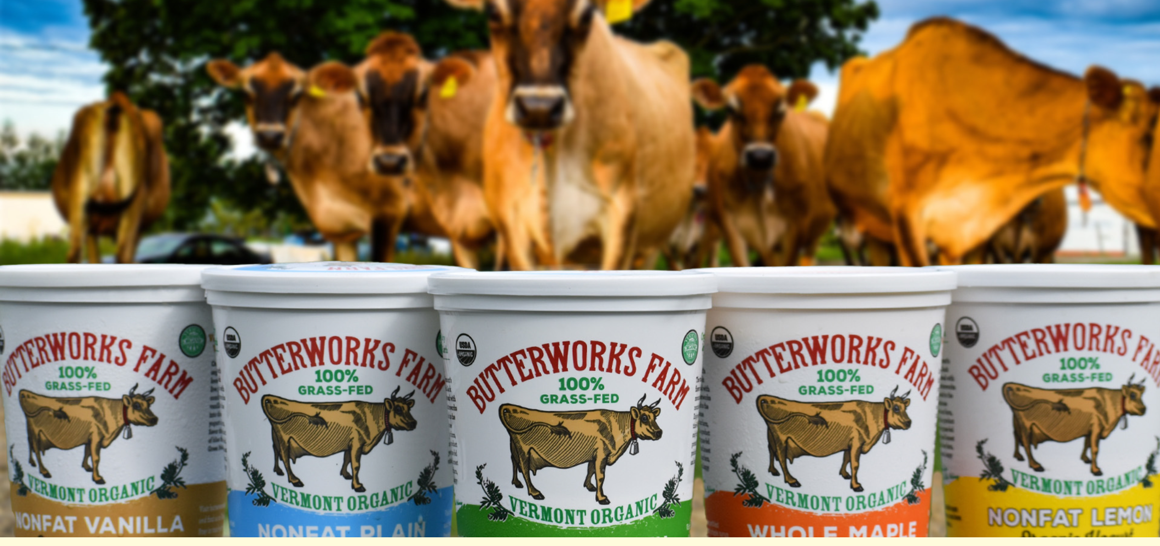
Overview: Organic dairy farming
Continued rising consumer demand for organic dairy products
139 million pounds of organic whole milk sold in US in May 2024
20.2% increase from 2023
USDA-AMS, 2024
Importance of dairy farming to Vermont
Milk represented 65% of state’s total farm sales in 2023
Highest proportion in the US
Progressive Dairy, 2023
Organic dairies in Vermont
As of 2021, 147 organic dairies in the state
Made over 187 million pounds of milk in 2021
USDA, 2022; VT Agency of Ag. and Markets, 2022
Butterworksfarm.com
Notes:
In May 2024, the US sold over 139 million pounds of organic whole milk, which represents a roughly 20% increase over the previous year. Although ranked 19th in overall milk production, dairy farming is an incredibly important part of Vermont’s agricultural sector; dairy comprised 65% of the state’s total farm sales in 2023, which is the highest proportion in the US. In 2021, Vermont had 147 organic dairy farms, which made over 187 million pounds of fluid milk. Although this represents only about 7.5% of the state’s total milk production that year, organic dairies remain important stakeholders in Vermont’s agricultural economy.
----
(at the time of the most current USDA Certified Organic Survey),
USDA-AMS. 2024. Agricultural Marketing Service, Dairy Market News: U.S. Organic Dairy Fluid Overview. Accessed July 19, 2024. https://www.ams.usda.gov/mnreports/ams_1594.pdf.

Slide 3
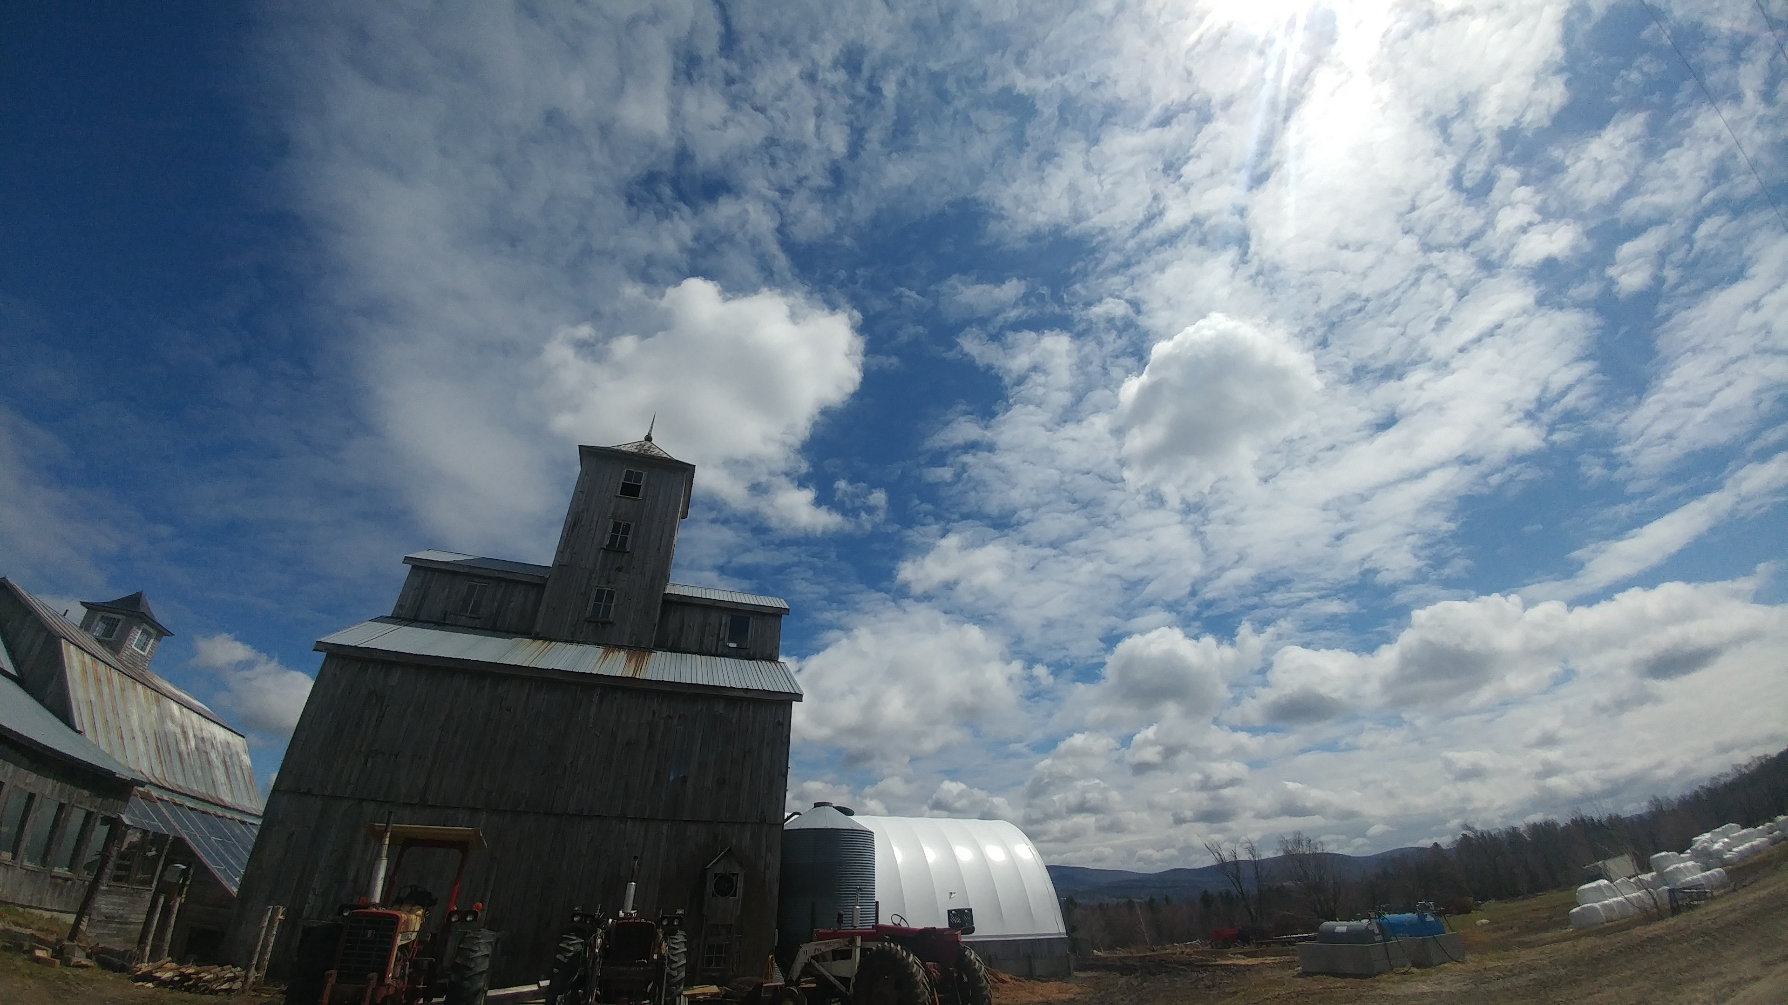
Overview: Organic dairy farming
Organic dairy farms are “special”
Smaller farms
Lower-producing cows
More likely to use tiestalls
Older cows
Fed less concentrate
Zwald et al., 2004; Stiglbauer et al., 2013
Subject to USDA National Organic Program regulations
Antimicrobial usage not allowed
Notes:
Although organic and conventional dairy farms do share many similarities, studies comparing the two systems have found some differences in both management practices and herd characteristics, including… herd size
But perhaps the most significant difference between the two systems is that under the rules of the USDA’s national organic program, antimicrobial usage is not allowed on organic dairy farms
----
(Zwald et al., 2004)
Stiglbauer et al., 2013
USDA. 2024. USDA Organic Regulations. Accessed June 7, 2024. https://www.ecfr.gov/current/title-7/subtitle-B/chapter-I/subchapter-M/part-205?toc=1

Slide 4
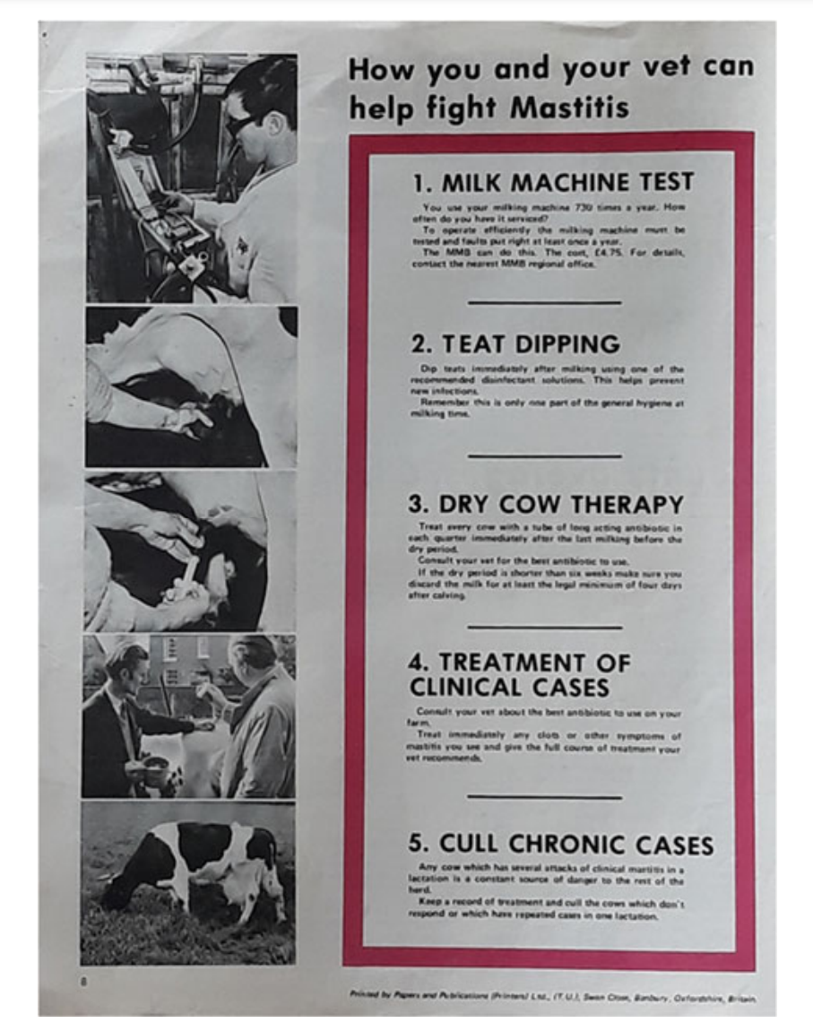
Overview: Udder health on organic dairies
Is udder health on organic farms worse than conventional farms without the ability to use intramammary antimicrobials?
Bulk tank
↑ Staphylococcus aureus, ↓ colony counts
Cicconi-Hogan et al., 2014
↑ / = Somatic cell count (SCC)
Stiglbauer et al., 2013; Levison et al., 2016
Cow-level
↑ / = SCC
Zwald et al., 2004; Hardeng and Edge, 2001; Mullen et al., 2013
↓ / = Clinical mastitis
Hamilton et al., 2006; Richert et al., 2013; Levison et al., 2016; Valle et al., 2007
↑ / = Prevalence by pathogen type
Mullen et al., 2013; Pol and Ruegg, 2007
X
X
Figures reprinted in Proceedings of National Mastitis Council, 2018
Notes:
The primary reason for antimicrobial drug usage in adult dairy cows in the US is for treatment of mastitis, which is inflammation of the mammary gland, most commonly caused by a bacterial infection. Traditionally, intramammary antimicrobial usage has been (and still is) an important component of udder health programs, as demonstrated by considering the classic 5 point plan put forth to control mastitis from 1971. This plan has become more detailed and nuanced over time, but 2 of the 5 points consisted of treating cows with intramammary antimicrobials (treatment of clinical cases and dry cow therapy). Although it’s an oversimplification, when we take those two points away, this demonstrates that without being able to use antimicrobials, organic dairy farms are left with limited available options to effectively treat and control mastitis
Even though the potential exists that udder health may suffer on organic dairy farms, research has found that the differences between the two systems really isn’t that clear-cut. At the bulk tank milk level, organic farms were more likely to be positive for the major mastitis pathogen Staphylococcus aureus, but less likely to have an increased colony count, whereas conflicting findings have been reported for somatic cell count (SCC), an indicator of inflammation of the udder and the level of subclinical mastitis occurring in a herd. At the cow level, some work found SCC was higher on organic farms, while others found no difference. A lower level of clinical mastitis has been reported for organic dairies, although this difference disappeared when controlling for lower milk production by organic cows. While some research found no difference, a large US study found that the quarter-level prevalence of most mastitis pathogens was higher on organic vs. conventional farms.
Taken as a whole, research suggests that differences in mastitis epidemiology may exist between conventional and organic dairy farms.

Slide 5

Specific objectives, Study 1:
1) Characterize the quarter-level prevalence of intramammary infections (IMI) caused by different microorganisms for organic dairies farms in Vermont using two different facility types:
-Tiestalls with shavings, bedded pack systems
Notes:
So, given the continued increase in demand for organic dairy products and the importance of organic dairies to Vermont, a longitudinal study was undertaken to describe the diversity of species causing intramammary infections, or IM,I on organic dairy farms in the state. The specific objectives of the project were to characterize the prevalence of IMI caused by different microorganisms, for organic dairies using a TS (the most common facility type in the state), and dairies using a bedded pack facility.
Organic dairy producers in the Northeastern US have expressed interest in bedded pack systems (BP) as an option to house cows during the non-grazing season, as these facilities integrate well with pasture-based farm systems. The inclusive term “bedded pack” is used to describe enclosed loose housing facilities, which are deeply bedded with organic material. As interest in BP grow among organic farmers, it is important to understand if there are any udder health implications for farms using this facility type.

Slide 6
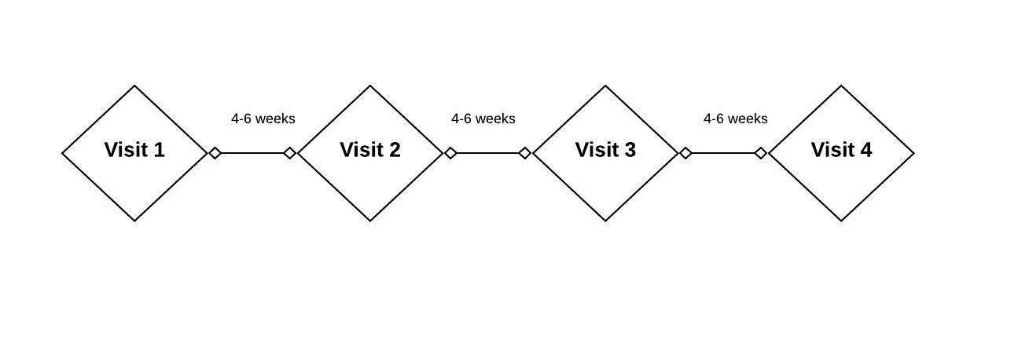
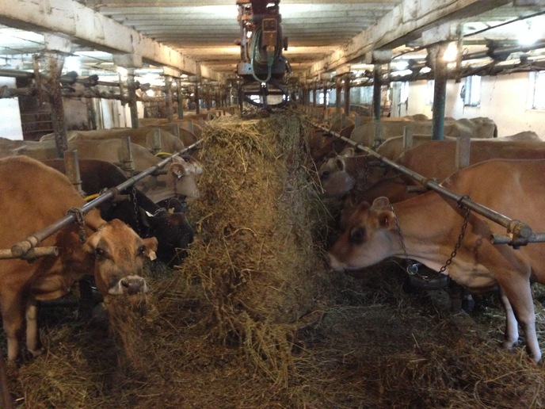
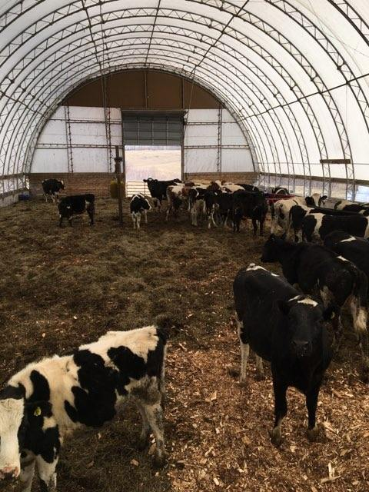
Methods: Sample collection
10 organic dairies
+/- 3 samplings/farm
35 cows per farm visit
Duplicate quartermilk samples
Notes:
This data comes from a longitudinal study conducted in Winter 2019-2020. Enrolled farms were a non-probability subsample of certified organic dairies in Vermont which: had participated in previous studies, milked between 35-120 cows and used either a tiestall barn bedded with shavings or a bedded pack system.
Most herds were sampled 3 times, with 4-6 weeks elapsing between each farm visit.
From each of the 10 enrolled herds, 35 early- to mid-lactation cows stratified by parity, current SCC, and DIM were chosen to be repeatedly sampled for the duration of the study. At each farm visit, duplicate quarter milk samples were aseptically collected from each lactating quarter immediately before milking for all enrolled cows. Around the time of the first farm visit, herd records were captured to obtain calving dates and parity for individual lactating cows.

Slide 7
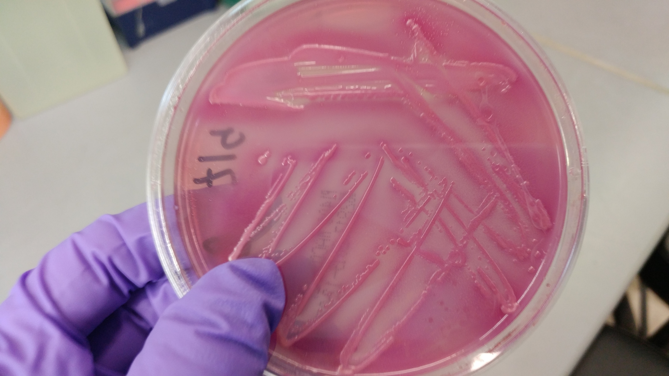
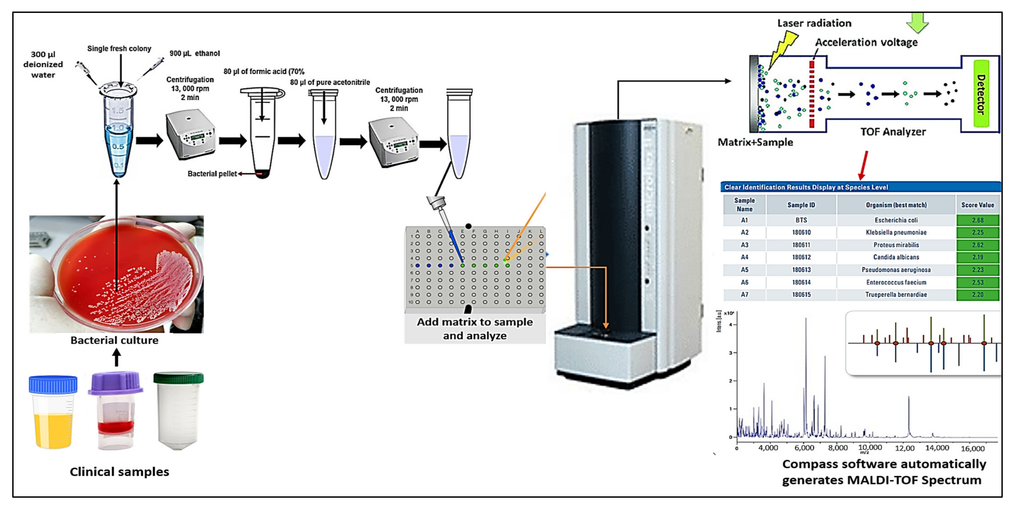
Methods: Bacteriological culture
Quartermilk samples plated in duplicate for aerobic culture
Quarter-level SCC by flow cytometry
Identification by MALDI-ToF (Adkins Lab, U. Missouri College of Vet. Med.)
Elbehiry et al., 2022
Notes:
After every farm visit, standard aerobic bacteriological culture of quartermilk samples was performed in duplicate to identify intramammary infections; additionally, an aliquot was frozen for determination of quarter-level somatic cell count
Bacteria deemed to be causing IMI were identified to the genus or species level with MALDI-ToF mass spectrometry
------
A quarter was considered positive for an IMI when greater than or equal to 1 CFU was identified with the same morphology for both duplicate samples, and negative when there was no significant growth in that quarter on either duplicate plate.
plated 10 uL milk; would be equivalent to 100 CFU/mL

Slide 8
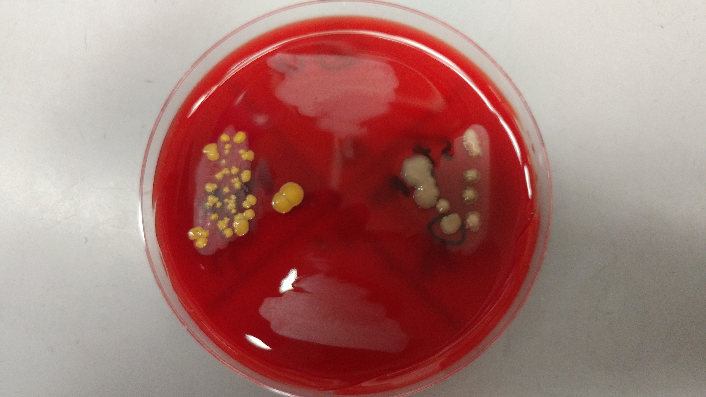
Methods: Data analysis
Assign status to quarter observation
1) No growth
2) Single pathogen infection
3) Mixed infection
4) Unknown
Descriptive analysis of quarter-level prevalence
By visit for each farm
For TS vs. FS
Overall
Notes:
Using the bacteriological status and species identification, a quarter-day IMI status was assigned to each quarter observation: 1) “no growth,” when there was no significant growth on either of the two plates; 2) “single pathogen infection,” a particular pathogen was identified in pure culture on both plates, 3) “mixed infection,” when 2 different pathogens were identified in mixed culture on both plates; and 4) “unknown,” when at least one of the two samples was “contaminated,” or when the set of quarter-milk samples did not meet the criteria for any of the previous categories. A quarter-day observation was included in the final data set if the IMI status was classified as no growth, single pathogen infection, or mixed infection.
A descriptive analysis only was performed to describe the pathogen-specific prevalence of organisms causing IMI, stratified by facility type. Quarter-level prevalence for each farm visit was calculated by dividing the number of quarters infected with a particular pathogen (or grouping of similar pathogens) by the total number of sampled quarters at risk where IMI status could be determined for that farm visit. Median and range of quarter-level prevalence for tiestalls and bedded packs were calculated over all 15 visits to each facility type, respectively. Overall median and range of quarter-level prevalence were calculated using all 30 visits to the 10 farms.
-----
Using the bacteriological status and species identification, a quarter-day IMI status was assigned to each quarter observation: 1) “healthy,” when there was no significant growth; 2) “single pathogen infection,” when ≥ 100 CFU/mL of a particular pathogen was identified in pure culture on both plates, 3) “mixed infection,” when ≥ 100 CFU/mL of 2 different pathogens were identified in mixed culture on both plates; and 4) “unknown” “contaminated,” when ≥ 1 of the 2 samples had more than 2 morphologically distinct isolates growing on a plate; 5) and “indeterminate,” when the set of quarter-milk samples did not meet the criteria for any of the previous categories (e.g., missing duplicate). A quarter-day observation was included in the final data set if the IMI status was classified as no growth, single pathogen infection, or mixed infection.

Slide 9
Table 1. Quarter-level prevalence of pathogens (or grouping of similar pathogens) causing intramammary infections [median (range)] by farm, stratified by facility type. The quarter-level prevalence represents the percent of sampled quarters infected with a particular pathogen over all sampled quarters at risk where intramammary infection status could be determined for that farm visit.
 |  | TS avg. | BP avg. | Overall
Num. farm visits |  | 15 | 15 | 30
Pathogen (group)
 | Non-aureus staphylococci and mammaliicocci | 19 (9.7-25.6) | 21.1 (12.8-39.8) | 20 (9.7-39.8)
 | Streptococcus uberis | 2.4 (0.9-6.1) | 3.6 (0-6.1) | 3.4 (0-6.1)
 | Staphylococcus aureus | 3.2 (0.9-4.1) | 2.6 (0-14.1) | 3.2 (0-14.1)
 | Corynebacterium spp.¹ | 1.6 (0-11) | 0 (0-20.2) | 0.9 (0-20.2)
 | Other gram-positive bacteria | 0.8 (0-1.8) | 0.8 (0-4.3) | 0.8 (0-4.3)
 | Streptococcus dysgalactiae | 0.8 (0-7.3) | 0 (0-2) | 0.4 (0-7.3)
Notes:
Table one shows the unconditional, median quarter-level prevalence and range for the six most-commonly found pathogens causing intramammary infections, stratified by facility type, for these 10 organic dairy farms. The pathogen or pathogen group is listed over here on the left, and the number of visits to each facility type is listed in this top row. Most farms were visited three times, but the number of visits ranged between 2 and 4. The median quarter-level prevalence for the 5 tiestall farms is found in this column, and in this column for the 5 bedded packs. The overall prevalence for all 10 farms included can be found in the column on the right.
Overall, the majority of IMI were caused by all non-aureus staphylococci and mammaliicocci species combined, a group known as NASM (median prevalence of 20%), followed by Strep. uberis (3.4%), and Staph. aureus (3.2%).
For the most part, quarter-level prevalence of IMI by pathogen was similar between BP and TS. NASM were the most commonly found for both facility types, followed by strep uberis and then staph aureus for bedded packs, vs. staph. aureus then strep uberis for tiestall farms.

Slide 10
Table 2. Quarter-level prevalence of seven most common non-aureus staphylococci and mammaliicocci (NASM) causing intramammary infections [median (range)] by farm, stratified by facility type. The quarter-level prevalence represents the percent of sampled quarters infected with a particular pathogen over all sampled quarters at risk where intramammary infection status could be determined for that farm visit.
 |  | TS avg. | BP avg. | Overall
Num. farm visits |  | 15 | 15 | 30
Pathogen (group)
 | Staphylococcus chromogenes | 13.1 (5.3-16.8) | 16.1 (6.5-21.8) | 14.6 (5.3-21.8)
 | Staphylococcus haemolyticus | 0.9 (0-1.8) | 2.7 (0-4.8) | 1.3 (0-4.8)
 | Staphylococcus simulans | 1 (0-4.3) | 0.9 (0-2.4) | 0.9 (0-4.3)
 | Staphylococcus equorum | 0 (0-3.7) | 0 (0-1.2) | 0 (0-3.7)
 | Staphylococcus agnetis | 0 (0-2.1) | 0.8 (0-3.6) | 0.8 (0-3.6)
 | Staphylococcus devriesei | 0 (0-2.7) | 0 (0-2.4) | 0 (0-2.7)
 | Staphylococcus warneri | 0 (0-2.6) | 0 (0-2.4) | 0 (0-2.6)
Notes:
Table two shows the unconditional, median quarter-level prevalence and range for the seven most-commonly found NASM species. So here, we’re breaking down that group-level prevalence from the previous table to the species level for the most common group of pathogens causing IMI. Again, we have species on the left, columns for prevalence in tiestalls and bedded packs, and for all 10 farms overall.
Far and away, the most commonly found NASM species was Staph. chromogenes, with an overall median prevalence of 14.6% and a range of 5.3-21.8% across all farm visits. The next most commonly found species, in order, were staph haemolyticus and staph simulans. Again, for the most part, quarter-level prevalence of IMI by NASM species was similar between BP and TS. One exception was staph. haemolyticus, where the median prevalence for bedded packs was three times that of the tiestalls farms.

Slide 11
Conclusions: Study 1
Quarter-level prevalence of IMI by pathogen similar between BP and TS
Staphylococcal and mammaliicoccal species (SaM) are dominant organisms causing IMI on organic dairy farms in Vermont
Quarter-level prevalence of IMI by pathogen similar to previous work for organic farms
Median quarter-level prevalence for NASM of 20%
Staph. aureus third most commonly identified IMI pathogen (3.2%)
vs. 13.6%; Peña-Mosca et al., 2023
Staph. chromogenes leading cause of IMI at species level
Notes:
Overall, quarter-level prevalence of IMI by pathogen was similar between BP and TS, except that TS had a slightly higher prevalence of staph aureus, and for NASM specifically, staph haemolyticus was more frequently found on bedded packs
The observed diversity and prevalence of species was generally similar to the limited research previously describing pathogen-specific prevalence of IMI on organic farms.
Organisms belonging to the group Staphylococci and mammaliicocci were the dominant pathogens causing IMI in this population of farms. This group is known as SaM and includes all NASM species as well as Staph. aureus
NASM prevalence specifically in the current study was similar to numerous previous studies reporting quarter-level prevalence for both organic and conventional herds.
Staph aureus was the third most commonly identified mastitis pathogen among these farms overall, although the median quarter-level prevalence of 3.2% was much lower than a study of post-partum heifers from 5 organic herds in the US (pena-mosca, 13.6%)
At the species level, staph chromogenes was the leading cause of IMI, which agrees with many studies from around the world of both conventional and organic dairy farms. The species distribution of NASM was similar to previous work, where a diverse number of species were identified but the prevalence of non-chromogenes IMI was low.
Bacteria belonging to NASM were the causing the majority of intramammary infections in these herds. So; Who are these mastitis pathogens?
~12 minutes?

Slide 12
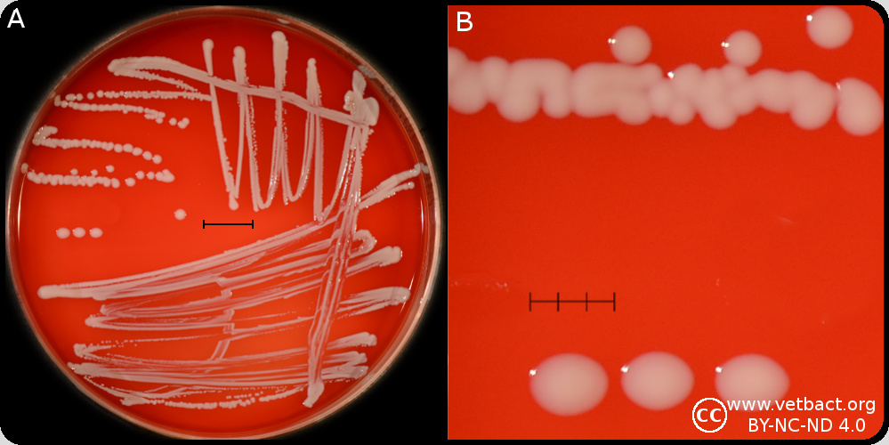
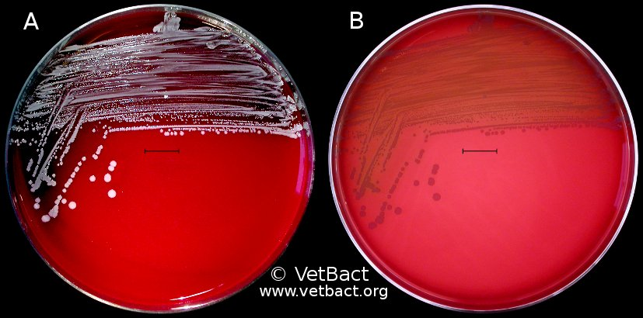
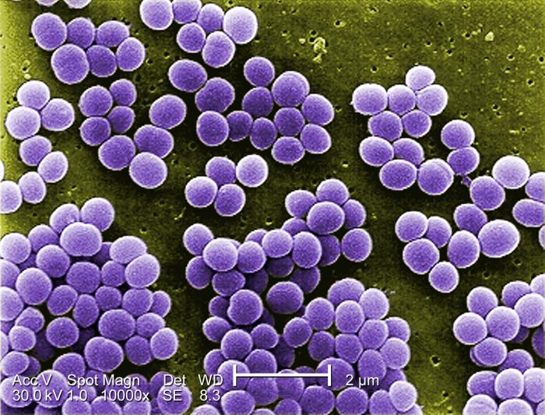
Non-aureus staphylococci and mammaliicocci (NASM)
Gram-positive group of bacteria comprised of a diverse group of species
S. chromogenes
S. simulans
S. xylosus
S. haemolyticus
S. epidermidis
NAS species differ from each other in how they behave as an intramammary pathogen
Ability to cause persistent infections
Nyman et al., 2018; Supre et al., 2011
Effect on milk yield
Thorberg et al., 2009
Degree to which they cause an inflammatory reaction in the udder (measured by quarter SCC)
Condas et al., 2017; Fry et al., 2014
Leading contributor to bulk tank milk somatic cell count on farms with “good” milk quality
“Major pathogens” Staphylococcus aureus, Streptococcus agalactiae well-controlled
Schukken et al., 2009
Vetbact.org
Vetbact.org
Phil.cdc.gov
Notes:
NASM is the leading group of pathogens responsible for intramammary infections (IMI) in dairy animals worldwide, making it crucial to understand their impact on udder health
Gram-positive group of bacteria comprised of a diverse group of different species
~23-25 species of NASM have been isolated from bovine milk
Following S. chromogenes, the most frequently identified NASM reported to be causing intramammary infections in dairy cattle are S. simulans, S. xylosus, S. haemolyticus, and S. epidermidis.
Within this group, species differ from each other in how they behave as an intramammary pathogen.. including
Ability to cause persistent infections
Effect on milk yield
Degree to which they cause an inflammatory reaction in the udder (measured by quarter SCC)
For many farms with good milk quality, where modern mastitis control practices have minimized the effects of bacteria considered to be “major” pathogens
quintessential examples of this are the organisms Staphylococcus aureus, Streptococcus agalactiae
… NASM mammary gland infections were found to be the leading contributor to bulk tank milk somatic cell count

Slide 13
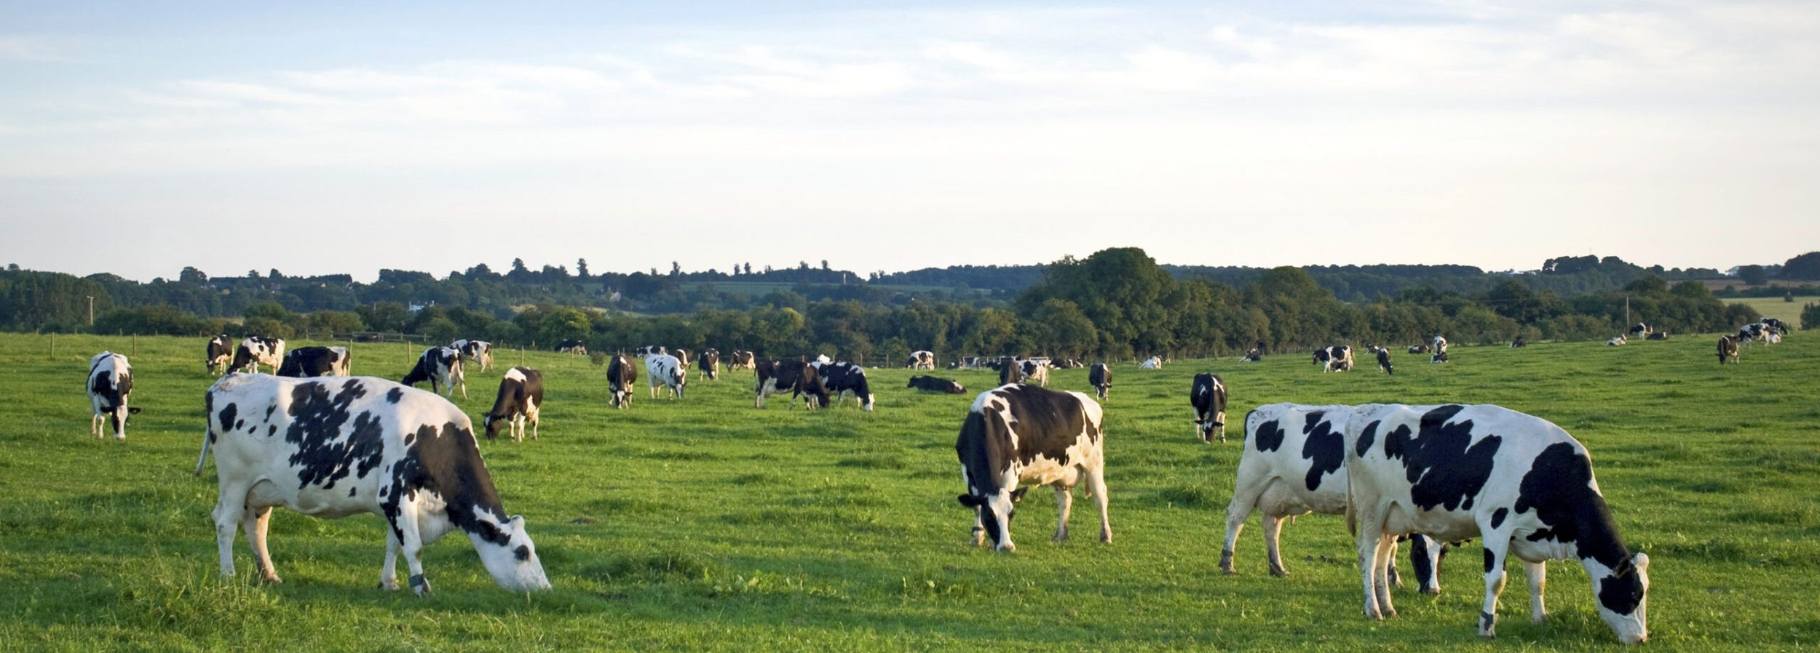
Specific objectives, Study 2:
1) Describe how quartermilk somatic cell count (qSCC) varied as a result of infection with the most frequently isolated staphylococci and mammaliicocci (SaM), in order to identify which species are more relevant to udder health for organic farms
Thedairyalliance.com
Notes:
In order to better understand which staphylococcal and mammaliicoccal (SaM) species are most relevant to udder health for organic dairies, a study was undertaken to describe how quartermilk somatic cell count (qSCC) varied as a result of infection with the most frequently isolated species causing intramammary infections on certified organic dairies in Vermont.
Although we were primarily interested in the effect of different NASM species on quarter SCC, Staph. aureus has previously been identified as a pathogen of particular concern for organic dairy farms in the US (including some of these farms), and it could serve as a relevant reference category for effect of NASM on SCC

Slide 14
Methods: Data set selection
Assign status to quarter observation
1) No growth
2) Infected with a single SaM species
3) Infected with two SaM species
4) Infected with non-SaM species
5) Unknown
Criteria for final data set:
No growth OR infected with single SaM species
Frequently observed (≥ 5 quarter observations)
Cow was ≤ 305 DIM
Valid qSCC
Notes:
A subset of the data from the previous study describing the intramammary infection status at the quarter level was used for the current study.
Using the bacteriological status and speciation information, a quarter-day IMI status was assigned to each quarter observation: 1) “no growth”; 2) “infected with a single SaM species,” 3) “infected with 2 SaM species,” 4) “infected with non-SaM species”; and 5) “unknown” if the sample status had been identified as contaminated or indeterminate as previously described.
A quarter-day observation was included in the final data according to following criteria: the IMI status was classified as no growth or infected with a single SaM species; that species was responsible for at least 5 observed quarter-day observations; it was collected from a cow ≤ 305 DIM at time of observation; and it had a valid associated quarter-level SCC measurement.

Slide 15
Methods: Statistical analyses
Somatic cell count (SCC) → somatic cell score (SCS)
Compare SCS of quarters infected with a single SaM species to no growth quarters
Linear hierarchical repeated measures mixed model
Outcome variable = SCS of a quarter on a given day; quarter-day IMI status = main predictor
Interaction evaluated
DIM x quarter-day IMI status
Random intercepts
Quarter | Cow | Herd
Correlation structure
Notes:
Raw quarter-level SCC was log-transformed to SCS in order to address the non-normal distribution of SCC data.
A linear hierarchical repeated measures mixed model was fitted to the data set in order to compare SCS of quarters infected with a single SaM species to quarters with no growth, in which the SCS of a quarter on a given day was the outcome variable, and the quarter-day IMI status (with no growth quarters as the reference value) was the main fixed predictor. Interaction between DIM and quarter-day IMI status was evaluated to allow the effect of a given IMI to vary as function of DIM. This interaction term was removed as it was found to be not significant, but DIM was still kept as a fixed predictor in the model, to allow it to adjust our SCS estimates as a function of DIM.
The hierarchical structure of the data was addressed by fitting random intercepts for quarter, cow, and herd. Samples collected at different time points for a given quarter were considered repeated measurements, and a spatial exponential correlation structure was used to account for this.
-------------------------------------
Statistical significance was determined using an F-test for interaction terms and a t-test for fixed effects, with significance declared at P ≤ 0.05. Final model fit was assessed by checking the homoscedasticity and normality of residuals
Descriptive statistics and visualizations were generated both to describe the variables of interest (SCS, quarter-day IMI status, DIM) as well as the hierarchical structure of the data set
(graphing of residuals vs. predicted values and Q-Q plots, respectively).
for both the correlation between milk samples collected on the same quarter, and for the variation of this correlation with the varying amount of time between sample collections.

Slide 16
S. aureus IMI at 91 DIM:
307,101 cells/mL
(197,323 - 477,951 cells/mL)
S. chromogenes IMI at 91 DIM:
80,376 cells/mL
(56,942 - 113,454 cells/mL)
*
*
Notes:
Moving on to results: In this composite figure, we have the least square means estimates for quarter somatic cell score (on the y-axis of each panel), as a function of intramammary infection with ten different staphylococcal species (indicated at the top left for each panel), by days in milk (along the x-axis for each panel).
In teal, each panel shows the estimate for quarter SCS (with the 95% confidence interval), for a quarter infected with that particular species, compared to a quarter with no growth (shown in orange, which you will notice is the same in each panel). The model estimates for each species are only presented for the range of days in milk which was observed for each type of IMI in the data set.
Overall, you can see that quarter SCS was higher for 9 of the 10 species causing IMI compared to uninfected quarters. Staph equorum was the only species which did not have a significantly higher SCS than no growth quarters.
In order to put this in a context that’s more readily understandable, we’ll convert some of these predicted results into an estimate of raw somatic cell count. The second highest cell count was for quarters infected S. aureus, which had an estimated quarter SCC of 307,101 cells/mL at 91 days in milk. Intramammary infection with the most frequent species, S. chromogenes, resulted in a quarter somatic cell count of 80,376 cells/mL for a quarter of a cow at 91 DIM. This is a somewhat modestly elevated SCC, but it is still consistently and reliably higher than quarters with no intramammary infection.
-------------------------------------------------------------------------------------------
Fixed effects: quarter-day IMI status (no growth, or IMI due to 10 different SaM species), and DIM as a third degree polynomial variable. The random effects, to account for the hierarchical nature of the data, are quarter, cow, and farm.
S. agnetis, S. aureus, S. chromogenes, S. devriesei, S. haemolyticus, S, hyicus, S. simulans, S. warneri, and S. xylosus
the interaction between IMI status and DIM was not significant (P = 0.25). This meant that both IMI status and DIM affected SCS, but that the effect of IMI status on SCS did not vary as function of DIM for these data. We could, therefore, remove the interaction with DIM.

Slide 17
Conclusions: Study 2
Species-level effect on inflammatory reaction (as measured by qSCC) for IMI due to staphylococci similar to previous work describing conventional herds
qSCC higher in quarters infected with 9 of 10 staphylococcal species
Increase in qSCC modest for most NASM, but have potential to increase bulk tank SCC
Notes:
What we found was that the species-level effect on inflammatory reaction (as measured by somatic cell count) was similar to previous work describing conventional herds. Compared to no growth quarters, SCC was higher in quarters infected with nine of 10 staphylococcal species identified.
Although the increase in quarter SCC was modest for most NASM species, their widespread nature has the potential to contribute to sizeable increases in bulk tank SCC in herds with “good milk quality,” which is generally defined as a bulk tank SCC of less than 200,000 cells/mL. From our first study, you’ll remember that 1 in 5 quarters were identified to have an IMI due to NASM species. The average BTSCC for the enrolled herds was 186,717 cells/mL. So, in herds like these, IMI due to NASM are the next target to further improve udder health.
From the longitudinal study which generated the dataset for both our first and second studies, Staph. chromogenes was far and away the most common species identified. So, let’s take a moment to focus on this ubiquitous mastitis pathogen.

Slide 18
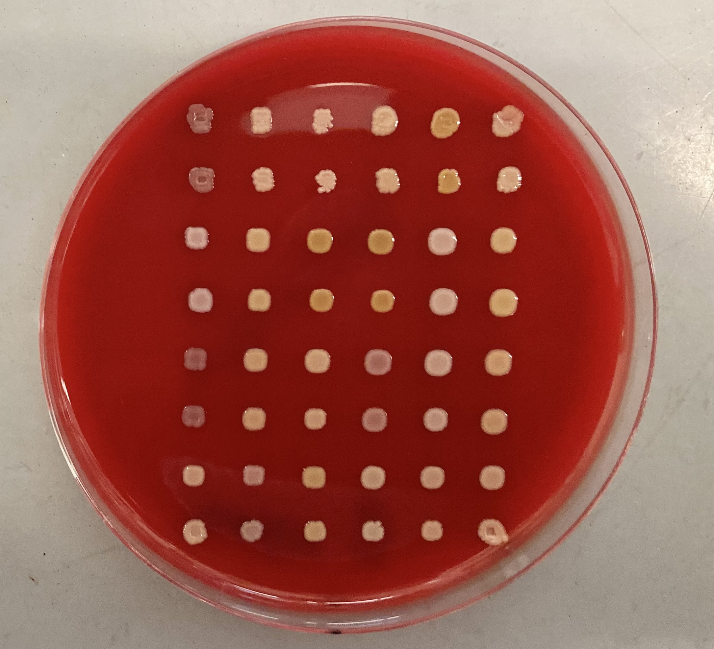
Overview: Staphylococcus chromogenes
Staph. chromogenes is of special concern
Most widespread
De Buck et al., 2021
One of the most persistent
Nyman et al., 2018; Thorberg et al., 2009
Increases SCC
Valckenier et al., 2021; Wuytack et al., 2020
Clinical NASM mastitis
Condas et al., 2017
Agriland.co.uk
Notes:
S. chromogenes is of special concern amongst the NASM species
Most widespread
One of the most persistent
It has consistently been shown to significantly increase in SCC (even to a level comparable to that of staph. aureus or other “major” mastitis pathogens
And among NASM positive quarters, it was the species most frequently isolated from cases of clinical mastitis

Slide 19
Diversity within S. chromogenes
Evidence suggesting intra-species variation in S. chromogenes
Variable persistence
Valckenier et al., 2021
Equally capable of causing low SCC IMI, high SCC IMI, clinical IMI
Condas et al., 2017
Variability in virulence/host immune response
Breyne et al., 2015; Piccart et al., 2016; Souza et al., 2016
Intra-species diversity within S. chromogenes: linking phenotype to genotype?
Notes:
Besides the marked differences between particular species of NASM, there is evidence suggesting variation within the same species. For Staph chromogenes specifically, this includes:
Variable persistence of IMI, with populations of both chronic and transient infections observed
A large Canadian study which found a similar proportion of chromogenes isolated from quarters with a low SCC, a high SCC, and clinical mastitis among NASM-positive quarters
Variability of virulence/host immune response to different strains
The next logical step in understanding this diversity within S. chromogenes is to see if we can link these differences in clinical behavior, or phenotype, to genotype- Do these phenotypic/behavioral differences have a basis in genetic variation?
------------------
There is currently limited evidence supporting a genetic basis for variations in strain pathogenicity among NASM species – a Belgian study found that 44% of the NAS isolates originating from quarters with clinical signs of mastitis carried three virulence genes including bap, a biofilm-associated protein, vs. only 19% of isolates from quarters with low somatic cell IMI which were positive for bap alone. Similarly, mecA, a gene conferring resistance to methicillin, was identified in 49% of NAS isolates from clinical mastitis, but only 6% of those from low somatic cell IMI
NASM isolates associated with severe mastitis more likely to have higher number genes encoding virulence factors vs. isolates associated with less severe mastitis
Wuytack et al., 2020
Variability of virulence/host immune response to different strains of S. chromogenes
Bacterial and somatic cell counts, as well as neutrophil responses, higher after inoculation with S. chromogenes from an intramammary infection than with S. chromogenes isolated from teat skin (Breyne 2015, mouse model; Piccart 2016, bovine)
S. chromogenes from an IMI showed a greater ability to adhere to and internalize into mammary epithelial cells than the S. chromogenes strain from teat skin (Souza 2016)
Generally, high levels of diversity among S. chromogenes from bovine IMI have been detected
Mostly heterogenous
Sheela 2021, Qu 2018, Gillespie 2009, Wuytack 2020
Difficult to generalize the results or compare the RAPD or PFGE types between distant geographical locations due to the small number of studies relating S. chromogenes, Also, variable ways of characterizing strain types
Little difficult to compare between studies, variable ways of characterizing strain types:
RAPD, PFGE, MLST
Besides the marked differences between different species in the group of bacteria known as non-aureus staphylococci, significant variation also exists within strains of the same species.
Difference in persistence of S. chromogenes IMI (Valckenier 2021, Mork 2012)
Half of the S. chromogenes intramammary infections associated with high SCC infection, half with low SCC (Condas 2017)
Variability of virulence/host immune response to different strains of S. chromogenes
Bacterial and somatic cell counts, as well as neutrophil responses, higher after inoculation with S. chromogenes from an intramammary infection than with S. chromogenes isolated from teat skin (Breyne 2015, mouse model; Piccart 2016, bovine)
S. chromogenes from an IMI showed a greater ability to adhere to and internalize into mammary epithelial cells than the S. chromogenes strain from teat skin (Souza 2016)
Differ in habitat niche
Some RAPD types found in milk, on skin, and feces; one only found in milk, and caused both clinical and subclinical mastitis (Wuytack 2020 Vet. Res.)
Certain indistinguishable strains of S. chromogenes across different cows within the same herd, others showed more genetic variability (Jenkins 2019)
Intraspecies variation in pathogenicity (ability to cause disease) has been demonstrated in varying effect on somatic cell count within a species [4, 14], difference in interaction with host immune cells [10, 11], persistence of infection [7, 19] and effect on milk production [8]. For S. chromogenes specifically, the link has been made between particular strain types and phenotypic differences in pathogenicity, such as interaction with host immune cells and inflammatory response [breyne/piccart/souza], and habitat niche [28, 29].

Slide 20
Notes:
Now, I want to hop back for a second, to some additional results from our second study. This box and whisker plot depicts the somatic cell score for each observation of SaM intramammary infections, as well as culture-negative control quarters. Quarters that were repeatedly positive for the same species contributed several somatic cell score measurements). Along the y-axis is the somatic cell score for each quarter observation, and along the x axis is the species associated with the observed intramammary infection. The red dotted line is at 200,000 cells/mL, which is indicative of an increased likelihood of subclinical intramammary infection.
What I i want to point out is the large amount of variability in SCS for quarters infected with chromogenes, which is seen here. For the 384 observations of chromogenes IMI, the RAW SCC ranged from the lower limit of detection to 6,100,000 cells/mL. Here are the quarter SCS observations for no growth quarters. Some IMI due to staph. chromogenes had an associated SCS which was similar to quarters with no growth, while others were elevated to a similar extent to those which had an IMI due to s. aureus, shown here, which is a major mastitis pathogen.
We had a large number of S. chromogenes isolates from our longitudinal study with an associated measure of host immune response (quarter somatic cell count), with which we could explore a genetic basis for differential pathogenicity of this organism.
Beyond being the most common species identified, S. chromogenes also caused the highest number of persistent infections when compared to other SaM species. In total, 136 persistent S. chromogenes IMI were identified, followed by S. aureus in a distant second, with 34 quarters having consecutive observations repeatedly positive for an IMI.
------------------------
Only observations of intramammary infections due to a single organism are included (no mixed infections).
Each box contains 50% of the data for a species, the median (line), and is bounded by the 25th and 75th percentiles. The upper whisker represents the largest observation less than or equal to the 75th quartile plus 1.5 times the interquartile range, while the lower whisker represents the smallest observation greater than or equal to the 25th quartile minus 1.5 times the interquartile range.
~21 minutes?

Slide 21

Specific objectives, Study 3:
Identify if distinct strain types of S. chromogenes are associated with persistent IMI where qSCC is consistently elevated (HIGH SCC IMI) vs. consistently low (LOW SCC IMI)
Identify if S. chromogenes from persistent HIGH SCC IMI are more likely to carry antimicrobial resistance genes (as determined by whole genome sequencing) vs. persistent LOW SCC IMI
Identify if S. chromogenes from persistent HIGH SCC IMI possess a larger number of genes encoding previously-described staphylococcal VF vs. persistent LOW SCC IMI
Notes:
Isolates from our longitudinal study were then used to investigate the epidemiology of S. chromogenes causing persistent IMI.
the specific objectives for our third study were to:
1) Identify if distinct strain types of S. chromogenes are associated with persistent IMI where qSCC is consistently elevated (HIGH SCC IMI) vs. consistently low (LOW SCC IMI)
2) Identify if S. chromogenes from persistent HIGH SCC IMI are more likely to carry antimicrobial resistance genes (as determined by whole genome sequencing) vs. persistent LOW SCC IMI
3) Identify if S. chromogenes from persistent HIGH SCC IMI possess a larger number of genes encoding previously-described staphylococcal VF vs. persistent LOW SCC IMI

Slide 22
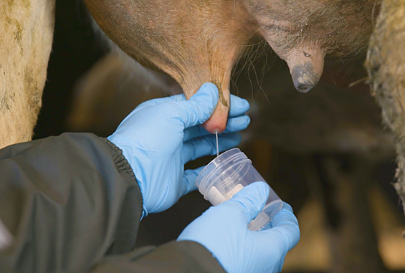
Methods: Selection of persistent IMI
Visit 1
Visit 2
Visit 3
S. chromogenes IMI
S. chromogenes IMI
S. chromogenes IMI
Select potentially persistent S. chromogenes IMI:
1) ≥ 2 quarter-day observations (sequential sampling events ~30 days apart)
2) IMI status can be determined for all associated sampling events
3) Infected with S. chromogenes only for all associated quarter-day observations
Milk sample collection photo: www.topfarmers.co.nz
Notes:
First, all potentially persistent Staph chromogenes IMI were identified from the dataset of our longitudinal study. A given quarter was considered to have a potentially persistent IMI if: 1) it had ≥ 2 quarter-day observations (from sequential sampling events approximately 30 days apart); 2) IMI status could be determined for all sampling events associated with that quarter; and 3) it was infected with S. chromogenes only for all associated quarter-day observations throughout the study.

Slide 23
Methods: Selection of persistent IMI
Visit 1
Visit 2
Visit 3
SCC ≥200,000 cells/mL
OR
SCC <200,000 cells/mL
SCC ≥200,000 cells/mL
OR
SCC <200,000 cells/mL
SCC ≥200,000 cells/mL
OR
SCC <200,000 cells/mL
Categorize persistent S. chromogenes IMI into SCC groups:
1) IMI associated with HIGH SCC, where all quarter-day observations had an associated SCC of ≥200,000 cells/mL
2) IMI associated with LOW SCC, where all quarter-day observations had an associated SCC of <200,000 cells/mL
Milk sample collection photo: www.topfarmers.co.nz
Notes:
Two groups were then selected from all potentially persistent S. chromogenes IMI:
Those with high SCC, where all quarter-day observations had a SCC of ≥200,000 cells/mL; and
Those with low SCC, where all quarter-day observations had a SCC of <200,000 cells/mL.

Slide 24
Methods: Confirming persistent IMI
Strain-typing to confirm persistent IMI
75 potentially persistent HIGH and LOW SCC IMI
198 associated isolates
Confirm all isolates associated with each S. chromogenes IMI truly persistent
Random amplification of polymorphic DNA (RAPD-PCR)
All isolates from a given persistent IMI analyzed in the same PCR, same gel
Same banding pattern, number, size of bands = same RAPD type
Same RAPD type = persistently infected with same strain
Cow A RH
Cow B LF
visit 1
visit 2
visit 3
visit 1
visit 2
visit 3
Notes:
There were 15 potentially persistent IMI which met the criteria for a HIGH SCC IMI, 60 which met the criteria for a LOW SCC IMI, and 61 which did not fall into either category.
All isolates associated with each of the 75 potentially persistent high and low SCC IMI were strain-typed using random amplification of polymorphic DNA (RAPD)-PCR, in order to confirm that each IMI was truly persistent (caused by the same strain type). The bands shown here are DNA fragments from PCR amplification of random segments of genomic DNA, using a primer of arbitrary nucleotide sequence. The resulting patterns give a semi-unique profile for that strain when run out on a gel.
The RAPD-PCR product of all isolates from a given persistent IMI within a quarter were run in adjacent lanes on the same gel, and isolates with the same banding pattern, number, and size of bands were considered to be the same RAPD type. If the isolates from all quarter observations of an IMI belonged to the same RAPD type, the quarter was considered persistently infected with the same strain.

Slide 25
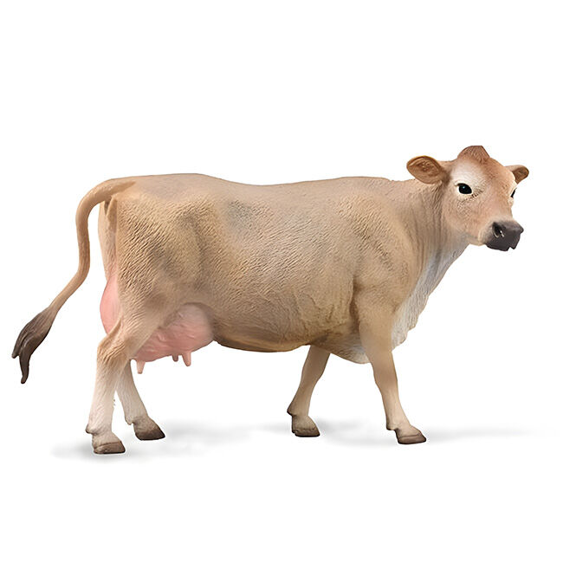

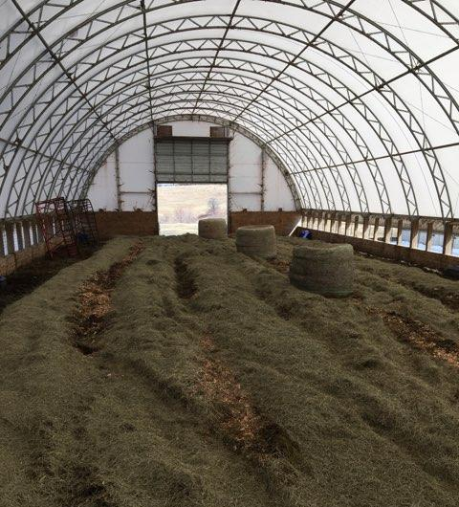
Methods: Isolate selection
Selection of HIGH and LOW SCC IMI
15 quarters with a persistently HIGH SCC IMI identified
15 quarters with a persistently LOW SCC IMI matched to HIGH SCC IMI
Paired by:
When possible:
Different quarter belonging to same cow
Same farm
Same facility type (TS vs. BP)
Days in milk
Parity
Selection of representative isolate for whole genome sequencing
Three quarter day observations = middle isolate in series
Two quarter day observations = arbitrary selection of first or second
Breyerhorses.com
Bankrate.com
S. chromogenes IMI
S. chromogenes IMI
S. chromogenes IMI
Notes:
From among the confirmed persistent IMI, 15 quarters with a persistently low SCC were selected to match the 15 quarters with a persistently high SCC. Quarters belonging to the same cow (different quarter) were selected when possible. If not, quarters were paired on farm, then facility type, and selected to ensure a similar DIM and parity. The 30 quarters selected were from 25 different cows on 7 different farms. Three cows contributed 2 quarters each, one cow contributed 3 quarters. From each of the 30 IMI, a representative isolate was chosen to undergo whole genome sequencing (WGS). For each persistent IMI which had 3 associated quarter-day observations, the middle isolate in the series was submitted, and for each with 2 associated quarter-day observations, 1 of the 2 isolates in the series was arbitrarily selected.

Slide 26
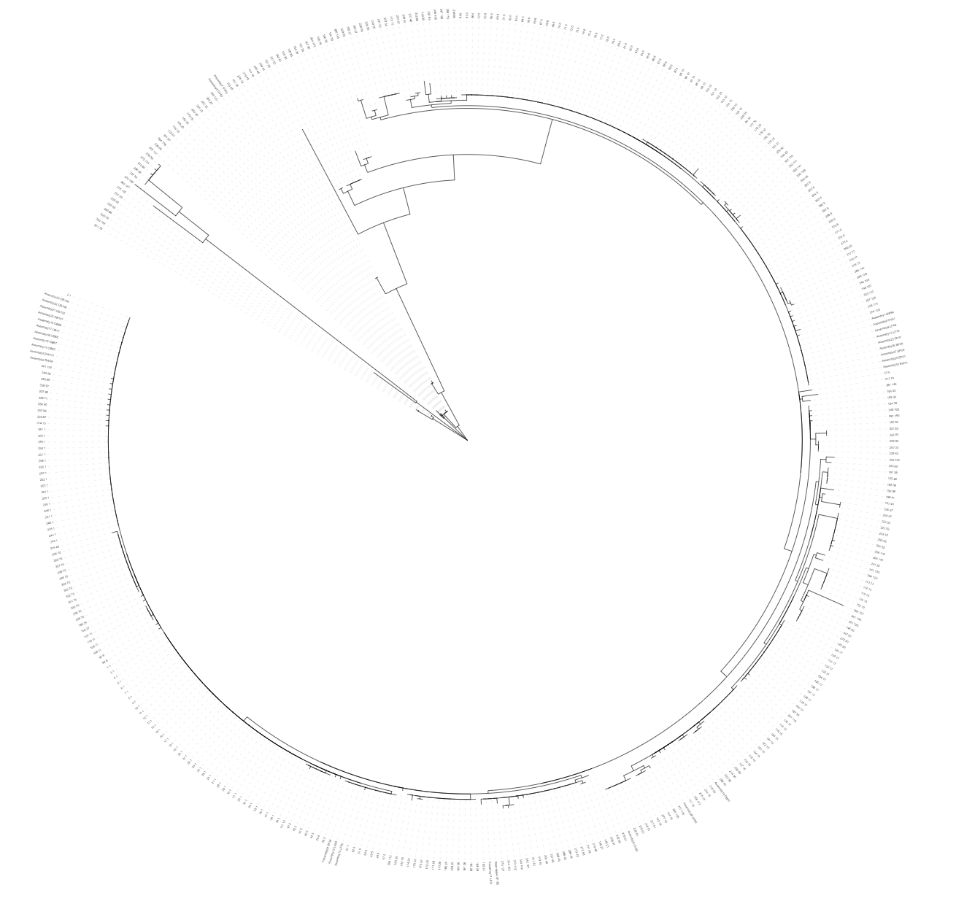
Methods: WGS and MLST
Whole genome sequencing
30 representative S. chromogenes isolates submitted for WGS
15 from persistently LOW SCC IMI and 15 from HIGH SCC IMI
DNA extraction from blood agar plates
Hybrid assembly of genomes
Long-read sequencing (Oxford Nanopore)
Paired-end sequencing (Illumina)
In silico multilocus sequence typing (MLST)
7-locus scheme for S. chromogenes (Huebner et al., 2021)
MLST 2.0, Center for Genomic Epidemiology, Technical University of Denmark
Novel alleles confirmed using Sanger sequencing
Identification of ST clusters
Notes:
Each of the 30 representative S. chromogenes isolates selected for WGS were recovered from frozen stock and grown on a blood agar plate, then sent to a commercial sequencing facility for DNA extraction, library preparation, long read sequencing using Oxford Nanopore, paired-end sequencing using Illumina, genome assembly, and annotation.
Multilocus sequence types (MLST) were predicted in silico from the annotated genomes using the 7-locus scheme described for S. chromogenes, with any novel alleles confirmed using traditional PCR and Sanger sequencing.
The 7-locus concatenated nucleotide sequence data were then combined with all publicly available concatenated MLST sequences for S. chromogenes, and the resulting file was used to construct a phylogenetic tree by maximum-likelihood algorithm – Isolates belonging to strain types which grouped together with a bootstrap value of ≥ 65% were classified as ST clusters.

Slide 27
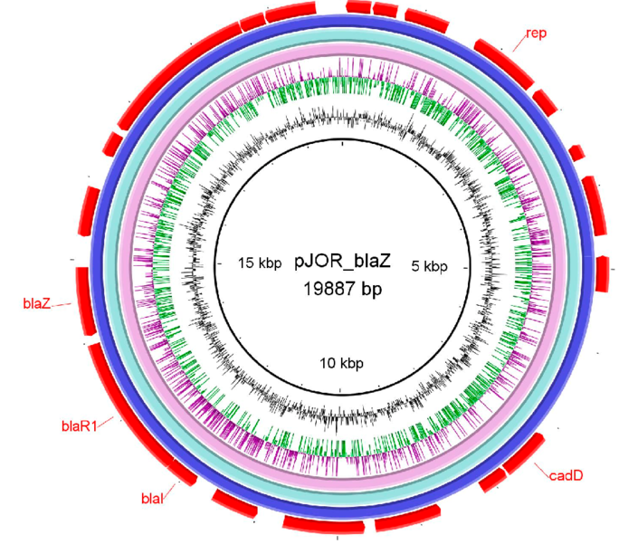
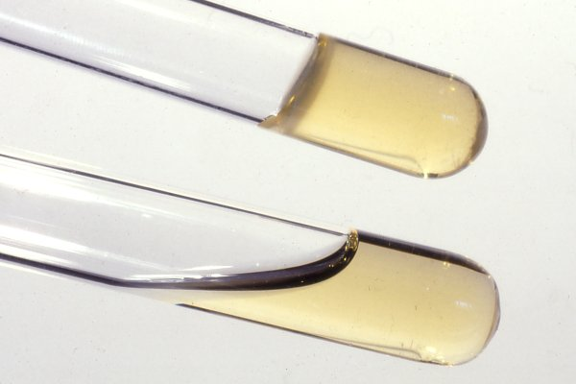
Methods: Identification of ARG and VF
Identification of antimicrobial resistance genes (ARG)
ARG identified from assembled genomes using ABRicate
ResFinder, CARD, MegaRES, AMRFinderPlus, ARG-ANNOT
Identification of virulence factors (VF)
VF identified using VFDB tool (Chen et al., 2016) and “blastp” search against published comprehensive dataset of staphylococcal VF (Naushad et al., 2019)
Best hit chosen based on H value (Fukiya et al., 2004)
Similarity between query protein sequence from database and assembled genomes
30% cut-off for sequence similarity, 50% cut-off for query length coverage
Select hit with highest H value
Categorization of VF factors
Five functional categories (Naushad et al., 2019)
Adherence, exoenzymes, host immune evasion, iron uptake and metabolism, toxins
Gaber et al., 2024
Vetbact.org
Notes:
ARG were identified from assembled genomes using ABRicate, which draws from 5 different databases
VF were identified from assembled genomes using the VFDB tool and a “blastp” search against a published comprehensive dataset of staphylococcal VF
After the blast search, the best hit of virulence genes for each genome was chosen based on H values, which is essentially a score of how well the query protein sequence from the reference database matched our assembled genomes.
Virulence factors were classified into 5 functional categories, including 1) adherence, 2) exoenzymes, 3) host immune evasion, 4) iron uptake and metabolism, and 5) various toxins
----------------------
A cutoff was established for sequence similarity of 30% and a query length coverage of 50%, with any hits having values below these cutoffs discarded from the data set. Hits from each query sequence were then arranged according to their H value, and the hit with the largest H value (highest sequence similarity and query length coverage) was selected in order to prevent 1 VF query returning hits to 2 different genes within a given genome.
(including hemolysins, leukocidins, leukotoxins, toxic shock syndrome toxin, exfoliative toxins, type VII secretion system genes, phenol-soluble modulins, enterotoxins, and exotoxins).
Briefly, an H value was calculated to determine homology between query protein sequences and blast hits (Fukiya et al., 2004). H values (in units of amino acids) between protein sequences were calculated using the following formula: H = VFid × Lm/Lq, where VFid represents the percent similarity between the VF query sequence and the identified protein sequence (expressed as proportion between 0 and 1), Lm represents the alignment length, and Lq denotes the length of the query sequence (Fukiya et al., 2004).

Slide 28
Methods: Statistical analyses
Descriptive statistics
Describe parity, DIM, quarter location, avg. SCC for LOW SCC and HIGH SCC groups
Mann Whitney U test, Fisher’s Exact test used to compare metrics
Parity, DIM, and quarter position = between LOW SCC and HIGH SCC groups
HIGH SCC IMI avg. SCC: 410,000 cells/mL
LOW SCC IMI avg. SCC: 98,500 cells/mL
Mixed-effects logistic regression models
Separate models where predictor was:
Strain type (ST)
ST cluster
ARG carriage
Number of VF identified
All models:
Outcome variable = SCC group (LOW vs. HIGH)
Random intercept for cow, herd
Notes:
Descriptive statistics were generated to compare parity and DIM of the cow, quarter location, and average SCC associated with each persistent IMI between the two SCC categories (HIGH vs. LOW). After checking distribution of the data, a Mann Whitney U test or Fisher’s Exact test as appropriate was used to compare metrics between the two groups.
Parity, DIM, and quarter position did not differ between the HIGH and LOW SCC IMI group. The median of the average SCC for the HIGH SCC IMI group was 410,000 cells/mL, which was significantly higher than the 98,500 cells/mL for the LOW SCC IMI group.
Separate mixed-effects logistic regression models were made using ST (as determined by MLST), ST cluster, ARG carriage, and number of VF identified as the predictor
For all models, SCC category was the outcome, and herd and cow were included as a random effects
-----
(range: 230,000-2,798,000 cells/mL) high
(range: 28,000-185,000 cells/mL) low

Slide 29
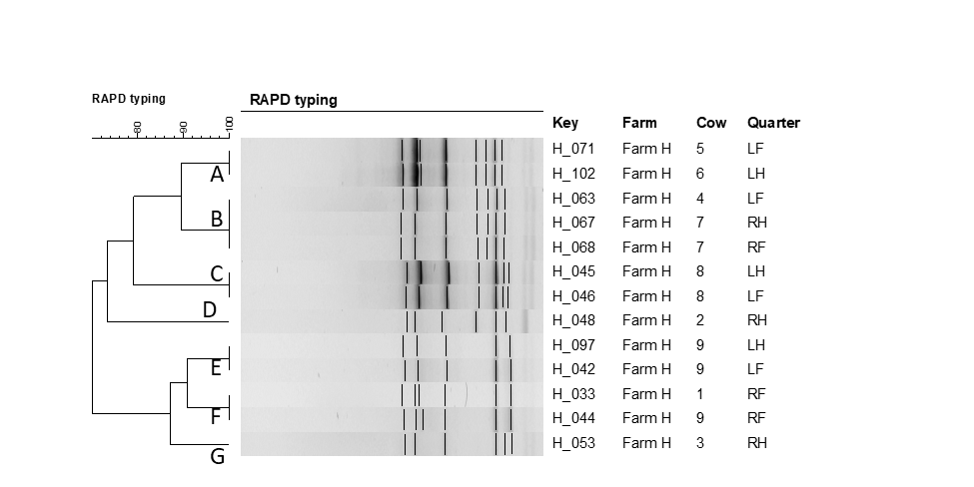
Notes:
So, moving on to some of our results… 74 out of 75 potentially persistent IMI which underwent strain-typing with RAPD were found to be caused by the same strain of S. chromogenes.
This is an example of a dendrogram of the RAPD fingerprints for 13 Staphylococcus chromogenes isolates representative of a persistently high or low SCC IMI, originating from Farm H. RAPD types were assigned an arbitrary letter based on clustering. On this particular farm, seven RAPD types were identified from the 13 strains causing persistent IMI.
In all 9 herds, there was at least 1 RAPD type of S. chromogenes identified to be causing multiple IMI in quarters belonging to different cows.

Slide 30
Table 3. Number of Staphylococcus chromogenes isolates associated with persistent bovine intramammary infections belonging to each strain type, stratified by SCC category.
SCC category | Strain type | ST cluster | No. isolates
HIGH | 5 | 5 | 1
 | 6 | 6 | 5
 | 25 | 25 | 2
 | 48 | 48 | 1
 | 136 | - | 1
 | 176* | 1 | 4
 | 177* | - | 1
LOW | 5 | 5 | 2
 | 6 | 6 | 4
 | 48 | 48 | 1
 | 51 | - | 1
 | 174* | 1 | 1
 | 175* | 1 | 1
 | 176* | 1 | 5
* Indicates a novel strain type of S. chromogenes not previously identified in PubMLST
Notes:
This table shows the number of Staphylococcus chromogenes isolates belonging to each strain type (as determined by multilocus sequence typing, shown in this column), stratified by SCC category, all the way to the left.
Ten different multilocus sequence types were identified among the 30 representative isolates, with 7 ST identified in each the HIGH and LOW SCC IMI categories. Four novel ST were identified, which are indicated with an asterisk. The most common ST identified were ST6 and ST176, with 18 isolates belonging to 1 of these 2 ST (9 isolates each). In a dendrogram constructed from concatenated nucleotide sequence data, 5 ST clusters were identified. There was only 1 cluster which was formed that included more than 1 ST, which identified ST 174, 175, and 176 as related to ST1.
Unsurprisingly, after looking at how most ST are evenly split between the two categories in this table, ST or ST cluster was not found to be a significant predictor of whether an isolate would be in the HIGH or LOW SCC IMI category.
----
Four ST were found in both SCC categories (ST 5, ST6, ST48, ST176), 3 were unique to the HIGH SCC IMI category (ST25, ST136, ST177), and 3 were unique to the LOW SCC IMI category (ST51, ST174, ST175).

Slide 31
Table 4. blaZ gene carriage by strain type for 30 Staphylococcus chromogenes isolates associated with persistent bovine intramammary infections. N = no blaZ carriage; Y = positive for blaZ carriage.
Isolate | ST | ST cluster | blaZ carriage
assembly_3 | 175 | 1 | N
assembly_2 | 174 | 1 | N
assembly_20 | 176 | 1 | N
assembly_21 | 176 | 1 | N
assembly_22 | 176 | 1 | N
assembly_23 | 176 | 1 | N
assembly_14 | 176 | 1 | N
assembly_15 | 176 | 1 | N
assembly_16 | 176 | 1 | N
assembly_17 | 176 | 1 | N
assembly_19 | 176 | 1 | N
assembly_10 | 5 | 5 | Y
assembly_24 | 5 | 5 | Y
assembly_12 | 5 | 5 | Y
assembly_1 | 6 | 6 | N
assembly_6 | 6 | 6 | N
assembly_9 | 6 | 6 | N
assembly_13 | 6 | 6 | N
assembly_30 | 6 | 6 | N
assembly_25 | 6 | 6 | Y
assembly_26 | 6 | 6 | Y
assembly_27 | 6 | 6 | Y
assembly_29 | 6 | 6 | Y
assembly_5 | 25 | 25 | N
assembly_7 | 25 | 25 | N
assembly_4 | 48 | 48 | Y
assembly_11 | 48 | 48 | Y
assembly_8 | 51 | 51 | Y
assembly_28 | 136 | 136 | N
assembly_18 | 177 | 177 | N
Notes:
Moving on to antimicrobial resistance… The only resistance determinant identified among the 30 S. chromogenes isolates was blaZ, which encodes a β-lactamase enzyme that hydrolytically destroys β-lactam antibiotics, and is the primary determinant of phenotypic resistance to benzylpenicillin in staphylococci. Ten of the 30 S. chromogenes isolates were positive for blaZ.: 6 isolates in the HIGH SCC IMI category and 4 in the LOW SCC IMI category. blaZ gene carriage, the sole type of AMR identified in these isolates, was not found to be a significant predictor of SCC category.
However, in this table, we see blaZ gene carriage may likely be a function instead of strain type. The boxes indicate separate ST clusters of isolates. For 4 of the 5 clusters with multiple isolates, blaZ gene carriage was uniform. All isolates belonging to ST5 and ST48 were blaZ positive, while no isolates belonging to ST25 and ST cluster 1 carried the gene. Only isolates belonging to ST6 were variable for blaZ carriage. As blaZ carriage was consistent for 4 of the 5 ST with multiple isolates, a formal statistical analysis exploring if ST predicted blaZ carriage was not possible.

Slide 32
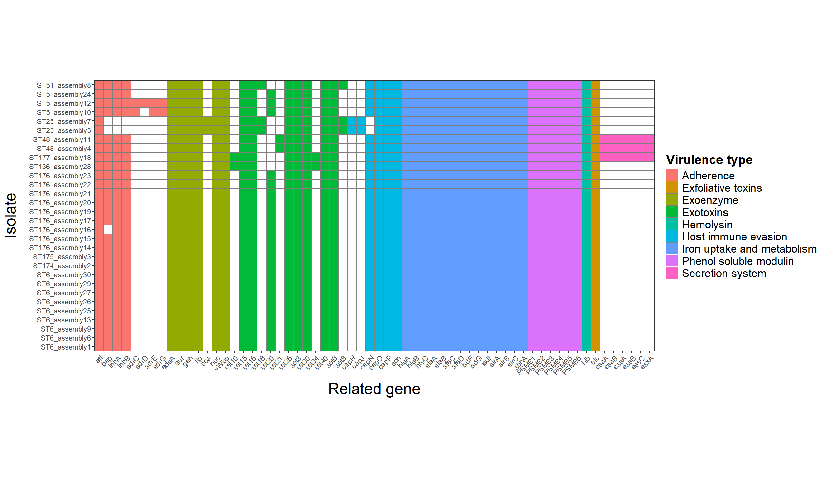
Notes:
Then lastly, moving onto the virulence genes. This figure shows the distributions of putative virulence genes for 30 Staphylococcus chromogenes isolates, with one on each row all the way over to the left. Isolates of the same strain type are listed sequentially. Each virulence gene is listed along the bottom, and the presence or absence of a gene is indicated by whether or not that particular box is filled in for an isolate. Virulence genes are color-coded by functional group, with the legend over here indicating what category each gene belongs to.
62 unique VF were detected among the 30 S. chromogenes isolates. There were 39 VF identified which were present in 100% of isolates, which included all genes associated with iron uptake and metabolism, and those associated with production of phenol-soluble modulins, hemolysins, and an exfoliative toxin.
Two S. chromogenes isolates in the current study were positive for coa, the gene encoding for the staphylocoagulase enzyme. coa has previously been identified in other species of non-aureus staphylococci, but has not been widely reported for S. chromogenes from bovine IMI. Another interesting finding was that the gene encoding exfoliative toxin type C was present in all 30 of the isolates in the current study. Exfoliative toxins in NAS have been identified from broiler chickens, but are not widely reported from isolates of bovine IMI.
The median number of VF per isolate found in both SCC categories was 44. Total number of VF identified per isolate was not found to be a significant predictor of whether an isolate would be in the HIGH or LOW SCC IMI category.
------
range for the HIGH category 44-51 and the range for the LOW category was 43-50.
//// Staphylocoagulase binds to prothrombin in the host, ultimately forming a fibrin clot which shields the bacteria from the host's defenses and causes localized clotting. ////
A total of 677 VF were identified among the 15 isolates in the HIGH SCC IMI category, compared to 670 total VF for the 15 LOW SCC IMI isolates. The median number of VF found in both categories was 44. There were 61 different VF detected in isolates belonging to the HIGH SCC IMI category, and 57 different VF found in the LOW category.

Slide 33
Notes:
These superimposed red boxes delineate the 5 ST clusters. As was the case with blaZ carriage, this demonstrates how the presence and distribution of virulence genes appears instead to be a function of strain type for S. chromogenes.
The number of VF identified belonging to each isolate in the 5 ST clusters showed little to no variation; total number of VF identified per isolate was uniform for 3 of the 5 ST (25, 6, 48), 8 of 9 isolates in ST cluster 1 contained the same number of VF (with the remaining one differing by 1 VF), and the isolates in ST5 ranged from 44-48 VF identified per isolate.
Visually, you can see that most of the limited differences in presence or absence of VF are specific to particular ST. This included the presence of capJ, capH (both related to capsule formation), and coa (staphylocoagulase enzyme), and the absence of fnbA, fnbB (both related to adherence), and capN for both isolates belonging to ST25; and the presence of set21 (exotoxins) in both isolates belonging to ST48.
As the number of VF identified per isolate was fairly consistent across a given ST, a formal statistical analysis exploring if a particular ST (or ST cluster) was a significant predictor of VF number was not possible.
-------
All isolates belonging to ST6 (n = 9) and ST25 (n = 2) had 44 VF identified, both isolates in ST48 (n = 2) had 50 VF identified, and 8 of the 9 isolates belonging to ST176 had 44 (1 had 43). The 3 isolates of ST5 had some variation in number of VF (44, 47, 48 genes each). ///
ST uniform for the most part- but, Assembly 12 and 10- little different from assembly 24; 12 and 10 from one farm, 24 from a different farm
//// Two isolates of singleton ST (ST177 and ST136) which were not classified as a cluster but were grouped together 42% of the time in the phylogenetic analysis were the only 2 isolates positive for the staphylococcal exotoxin genes set10 and set34. An exception to this was that the full complement of genes associated with the type VII secretion system (esaA, esaB, essA, essB, essC, esxA) were only found in isolates from ST48 and ST177, which were not clustered together in the phylogenetic analysis. ////

Slide 34
Conclusions: Study 3
Penicillin resistance common in mastitis isolates from organic farms
Some strains of S. chromogenes may be contagious
Strain type, ARG carriage, or number of VF did not predict SCC status
Strain type appears to predict blaZ carriage, VF presence and distribution
Identification of two notable virulence factors
Staphylocoagulase, exfoliative toxin type C
Notes:
Findings from our third study underscore the importance of Staph. chromogenes specifically as a mastitis pathogen. We found 33% of isolates causing persistent IMI carried the blaZ gene encoding penicillin resistance, which is especially noteworthy as these isolates originated from organic farms and are not experiencing selective pressure from antimicrobial use. Furthermore, our findings indicate that certain strains of chromogenes may exhibit contagious behavior within a herd, though these observations could also align with transmission via a common point source.
This work contributes to the understanding of intraspecies diversity within Staph. chromogenes. 10 ST were identified to be causing 30 persistent IMI, including four novel ST. The AMR and virulence profile for 30 Staph. chromogenes were described from whole genome sequence data. Although strain type, ARG carriage, or number of VF did not predict SCC status, findings seem to indicate a genetic basis for virulence and AMR carriage in Staph. chromogenes.
Lastly, two virulence factors were found which have not yet been widely reported to be present in isolates of staph chromogenes from bovine IMI, which were
staphylocoagulase, exfoliative toxin type c
----
~38 minutes?
2 ST25 from same farm
2 ST 48 from 2 different farms
ST6 from 5 farms
ST5 from 2 farms
ST1 from 2 farms

Slide 35
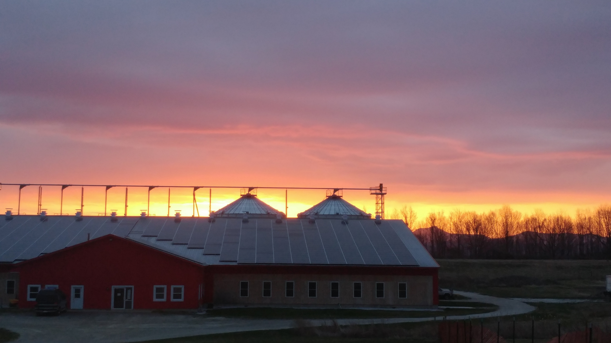
Directions for future research
Further work exploring antimicrobial resistance for S. chromogenes
Concordance between blaZ and penicillin resistance
Where is blaZ carried?
Notes:
This work has brought to mind a lot of directions for future research...
A fairly high proportion of isolates were positive for the blaZ gene, but carriage of a particular resistance gene does not always translate into phenotypic resistance. It would be interesting to explore the concordance between phenotypic and genotypic resistance results for these isolates. Twelve of the 30 isolates from this project underwent phenotypic susceptibility testing for penicillin for a different study, with 100% agreement between blaZ carriage status and susceptibility. 4 out of 4 isolates positive for blaZ were penicillin resistant, while 8 isolates negative for blaZ were penicillin susceptible.
A related question would be identifying whether the blaZ gene is located on a mobile genetic element (usually a plasmid) or chromosomally for these isolates. Location of blaZ carriage is not well characterized for Staph. chromogenes originating from bovine IMI. Some preliminary work has shown that out of the 10 blaZ positive isolates in the current study, 4 were negative for plasmid carriage. Resistance genes located on mobile genetic elements are more efficiently transmitted through populations of bacteria, so location of the gene would have ramifications for the transmission of penicillin resistance among staphylococci causing IMI on dairy farms.

Slide 36
General conclusions and overall significance
NASM = significant mastitis pathogens
Contributed to fundamental knowledge of epidemiology of staphylococci causing IMI
Better understanding of epidemiology leads to more effective, targeted control and prevention
Notes:
Although I’m certainly not the first or last researcher to say as much, this work underscores that non-aureus staphylococci and mammaliicocci are indeed deserving of serious attention and should no longer be dismissed as 'minor' mastitis pathogens, as they have been previously classified. Taken together, this research generated foundational knowledge about the epidemiology of staphylococci causing mastitis on organic dairy farms in Vermont. While all dairy producers rely on best management practices to support cow health, mastitis control is of the utmost importance in the prevention of IMI on organic farms. Better understanding the epidemiology of mastitis pathogens leads to more effective measures which prevent or limit transmission of IMI. Mitigating the effect of mastitis caused by staphylococci through more effective, targeted prevention and control measures helps dairy producers achieve quality price premiums and results in a higher-quality product for consumers.

Slide 37
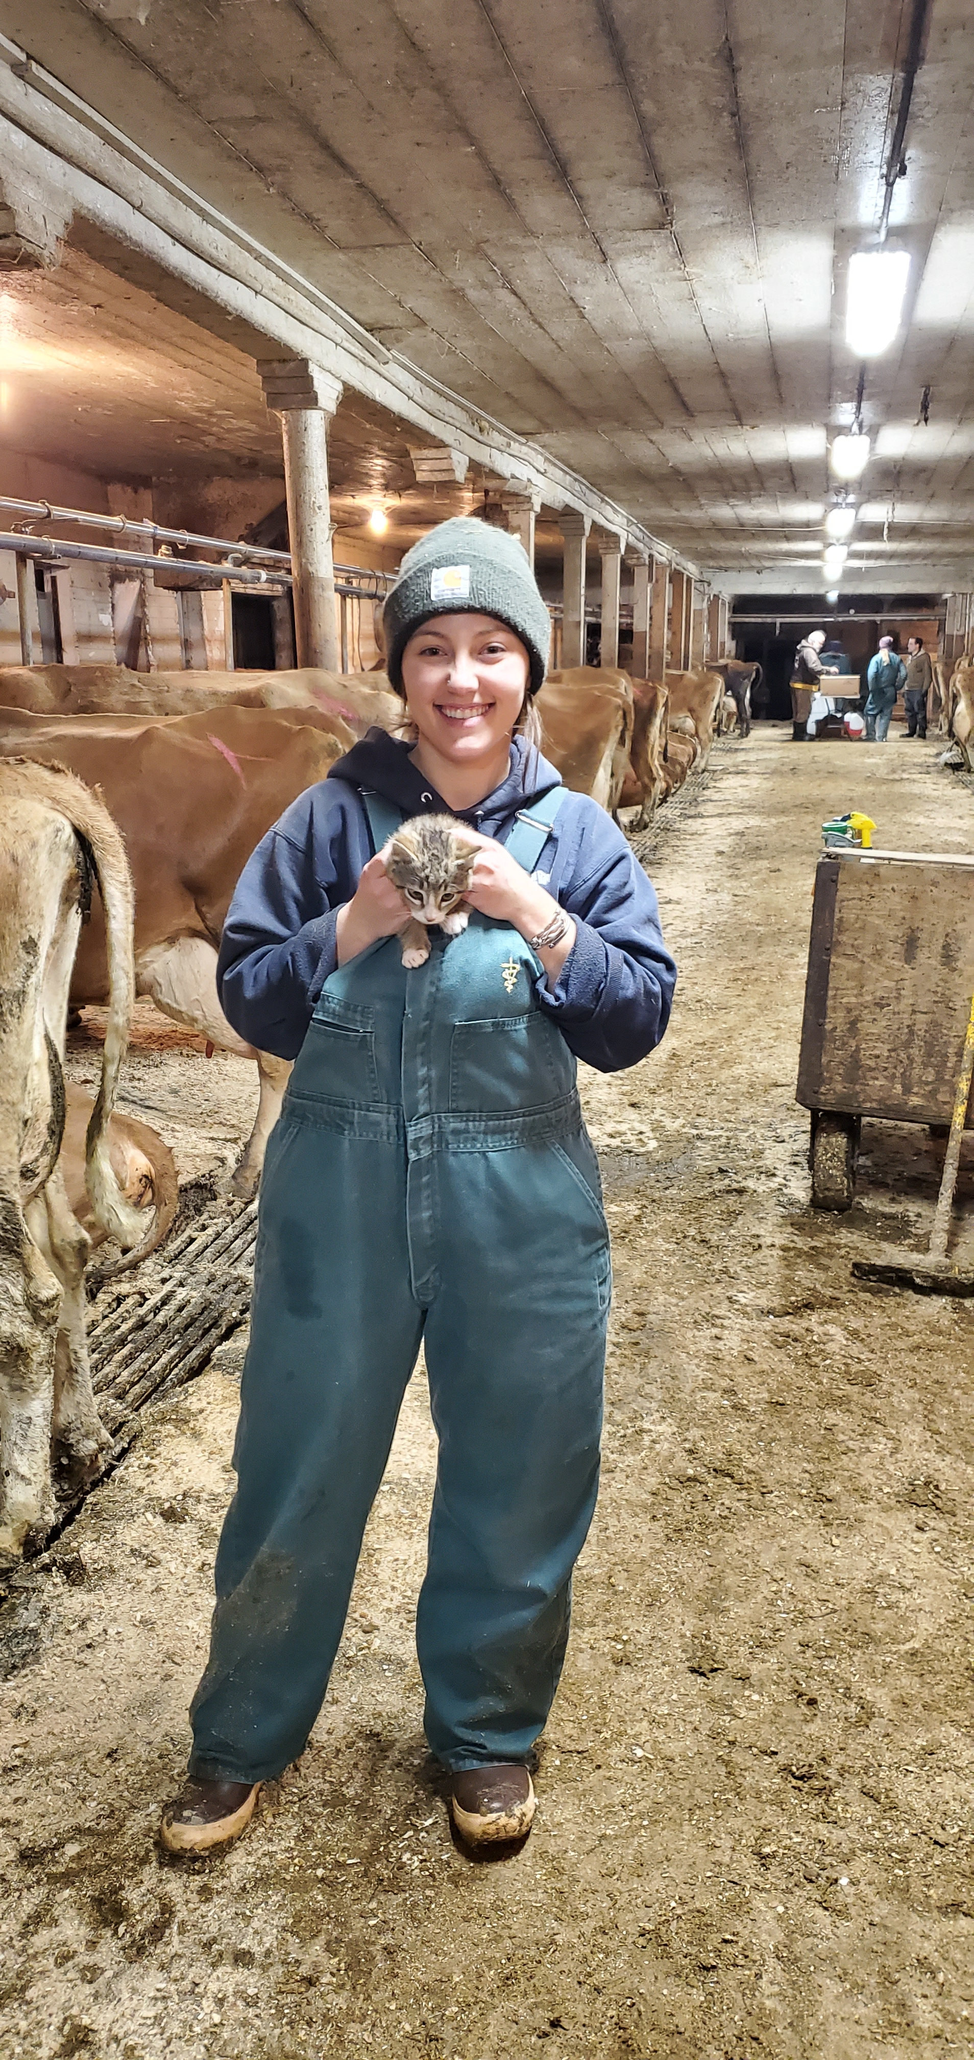
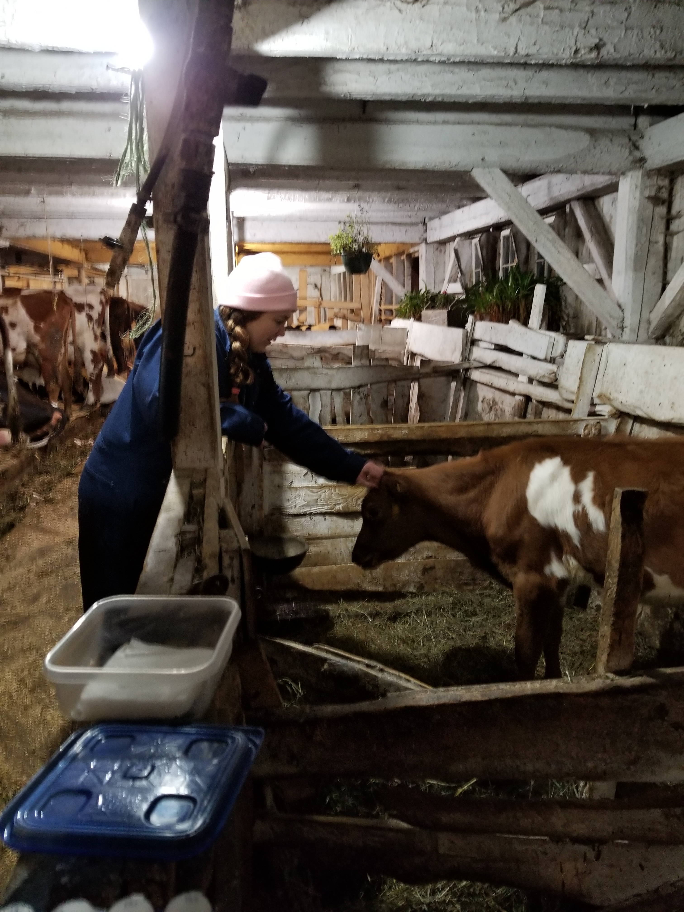
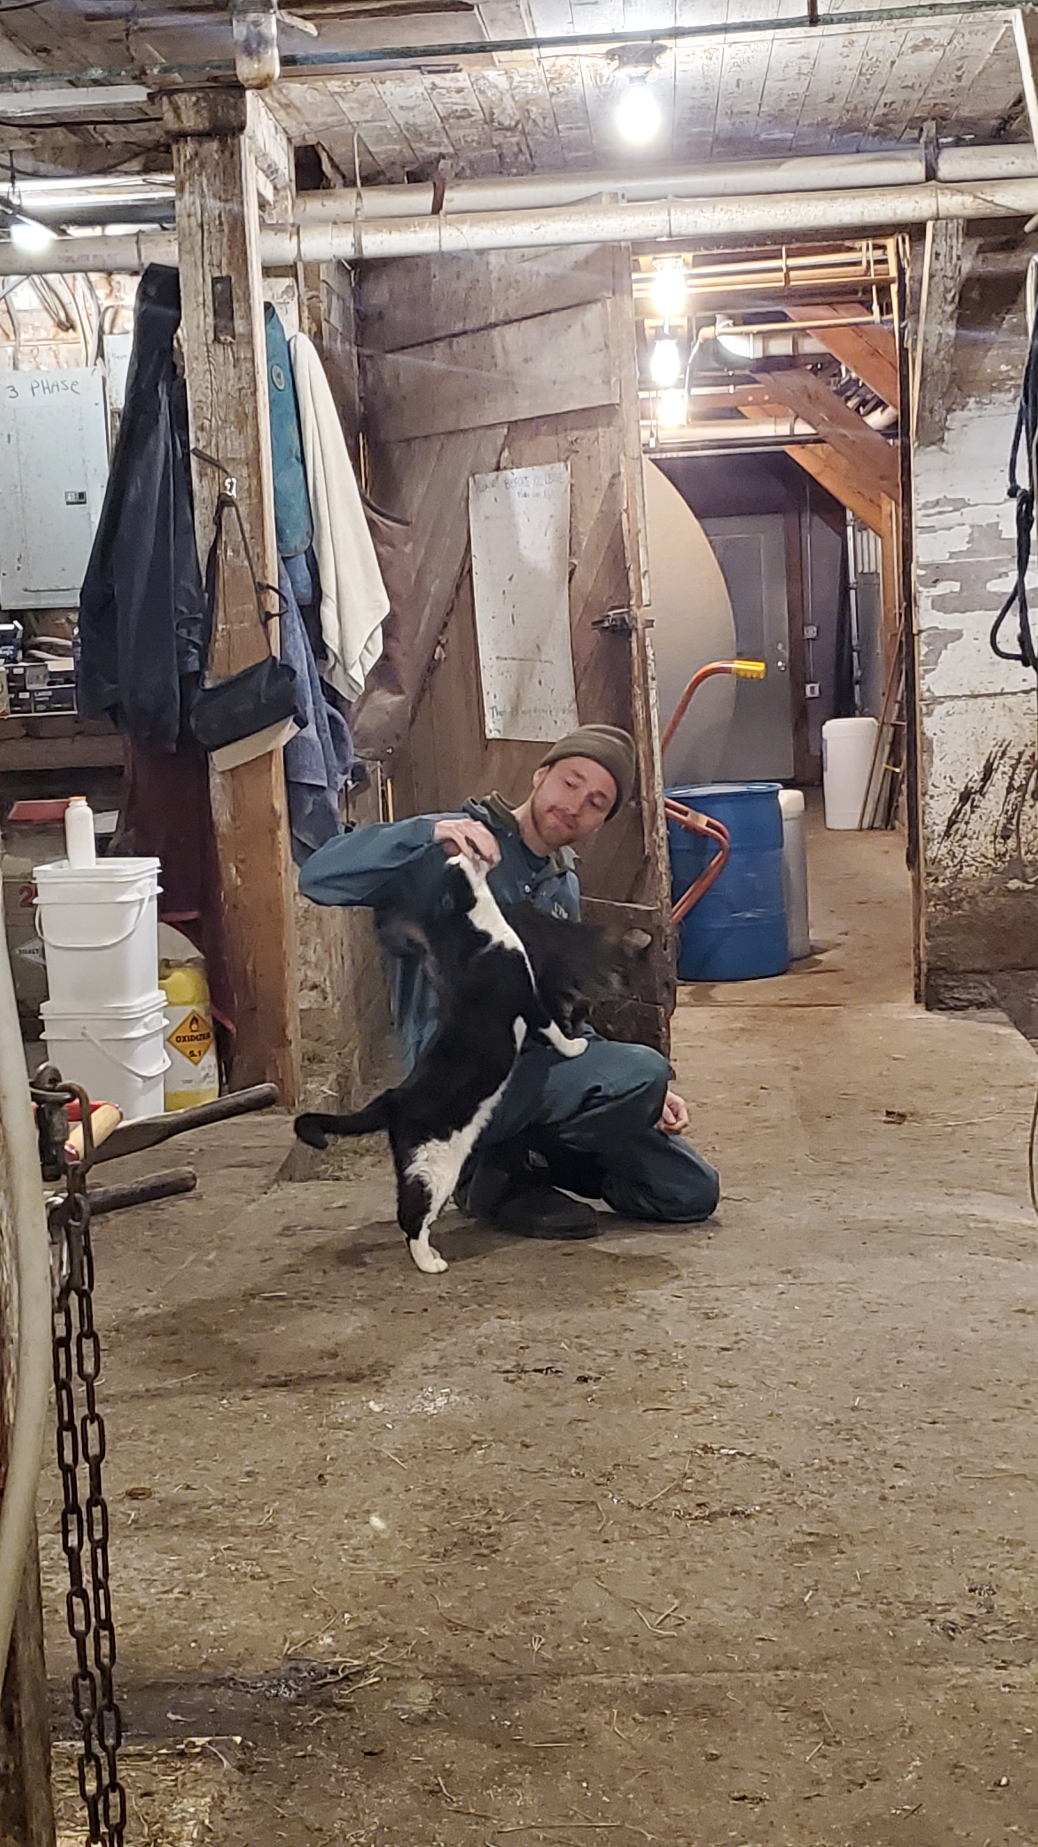

Acknowledgements:
Dr. John Barlow, Dept. of Animal and Veterinary Sciences, University of Vermont
Dr. Sandra Godden, Dept. of Veterinary Population Medicine, University of Minnesota College of Veterinary Medicine
Dr. Deborah Neher, Dept. of Agriculture, Landscape, and Environment, University of Vermont
Dr. Julia Smith, Dept. of Animal and Veterinary Sciences, University of Vermont
Dr. Jessica Crothers, Dept. of Pathology and Laboratory Medicine, University of Vermont
Dr. Pamela Adkins, Dept. of Veterinary Medicine and Surgery, University of Missouri
Dr. Simon Dufour, Faculty of veterinary medicine, Université de Montréal
Dr. Ashma Chakrawarti, Dept. of Surgery, University of Minnesota Medical School
Field study research team
Members of the Barlow Lab
Participating organic dairy producers
Vermont Agriculture and Environmental Laboratory, Randolph Center, VT
St. Albans Cooperative/Dairy Farmers of America, St. Albans, VT
Jennifer Timmerman and the Laboratory for Udder Health, Veterinary Diagnostic Lab, University of Minnesota
SeqCoast Genomics, Portsmouth, NH
Funding:
USDA Organic Agriculture Research and Extension Initiative (USDA-NIFA grant 2018-51300-28561)
USDA-NIFA Predoctoral Fellowship grant (USDA-NIFA grant 2022-67011-36567)
USDA-NIFA project 2022-67015-37123
Notes:
… and with that, I’d like to acknowledge everyone who’s contributed to the work included in this dissertation:
Of course, my advisor…
Members of my committee, dr. Sandra godden, dr. deb neher, who served as committee chair, dr. Julie smith and dr. jess crothers;
An additional thank you to dr. godden and dr. neher who I am also fortunate enough to have as co-authors on a publication included in this dissertation
I also wanted to take a moment to acknowledge collaborators from other institutions who made important contributions to this work. this includes:
Dr. pamela Adkins at Missouri,
Dr. Simon Dufour, from the university of montreal
And the relatively newly minted Dr. ashma chakrawarti, a recent PhD graduate from the Barlow lab, who is now in Minnesota
I also want to acknowledge Our amazing research team of UVM undergraduate students and recent grads who helped with our field trial
Members of the Barlow Lab over the years
and participating producers; for giving us their time and allowing us to collect samples; we truly could not have completed any of this work without them, and I very much appreciate them welcoming a bunch of students onto their farms during the busiest time of their day
funding for the field trial came from a USDA OREI grant, and my funding has come both from a USDA-NIFA predoctoral fellowship and now currently from a separate USDA-NIFA grant
Thank you everyone for your time and attention, and at this point I’d love to welcome any questions or discussion

Slide 38
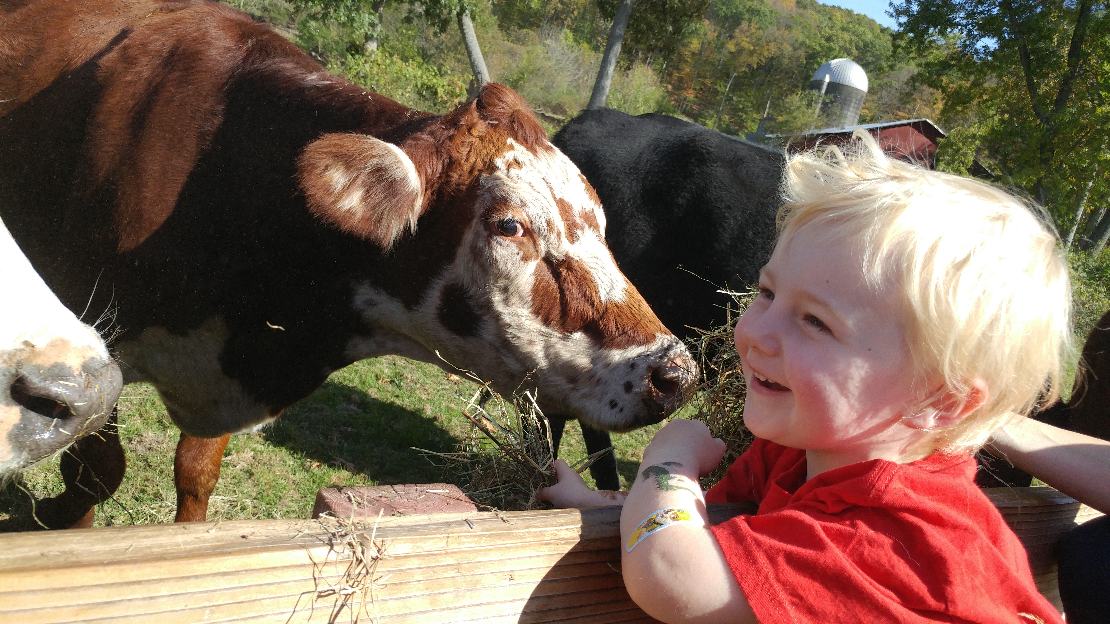
Thank you for your time!
Questions?

Slide 39
Extra slides

Slide 40
Isolate | ST | ST cluster
BP1_113 | 175 | 1
BP1_099 | 174 | 1
TS3_101 | 176 | 1
TS3_102 | 176 | 1
TS3_108 | 176 | 1
TS3_109 | 176 | 1
TS3_063 | 176 | 1
TS3_067 | 176 | 1
TS3_068 | 176 | 1
TS3_071 | 176 | 1
TS3_098 | 176 | 1
BP3_055 | 5 | 5
BP3_069 | 5 | 5
BP4_038 | 5 | 5
BP1_094 | 6 | 6
TS2_051 | 6 | 6
BP3_048 | 6 | 6
BP3_075 | 6 | 6
BP4_041 | 6 | 6
BP4_054 | 6 | 6
BP4_055 | 6 | 6
BP4_061 | 6 | 6
BP5_071 | 6 | 6
TS2_050 | 25 | 25
TS2_062 | 25 | 25
BP2_150 | 48 | 48
BP3_061 | 48 | 48
TS3_091 | 177 | 15x
BP4_056 | 136 | 15x
TS2_069 | 51 | XX
2-ST25 from same farm
2-ST48 from 2 different farms
ST6 from 5 farms
ST5 from 2 farms
ST1 cluster from 2 farms
Notes:
2 ST25 from same farm
2 ST 48 from 2 different farms
ST6 from 5 farms
ST5 from 2 farms
ST1 from 2 farms

Slide 42
Carriage of blaZ by SCC category
blaZ -
blaZ +
High
n = 9
n = 6
SCC category
Low
n = 11
n = 4
Notes:
Moving on to antimicrobial resistance… The only resistance determinant identified among the 30 S. chromogenes isolates was blaZ, which encodes a β-lactamase enzyme which hydrolytically destroys β-lactam antibiotics, and is the primary determinant of phenotypic resistance to benzylpenicillin in staphylococci
Ten of the 30 S. chromogenes isolates were positive for blaZ. This mosaic plot shows the proportion of blaZ positives isolates in each SCC category, with blaZ gene carriage along tohe top, and SCC category along the left side. There were 6 blaZ positive isolates in the HIGH SCC IMI category and 4 in the LOW SCC IMI category. As fairly evident from this figure, blaZ gene carriage was not found to be a significant predictor of SCC category (HIGH vs. LOW) for an isolate in a mixed-effects logistic regression model.

Slide 43
Methods: Overview of enrolled farms
Notes:
Here’s an overview of our 10 enrolled herds. The median number of lactating cows was 59 (range: 39-77), with a variety of breeds represented. You can see that the weighted average somatic cell count from the last test date prior to starting the study ranged pretty widely between the enrolled herds,
Five farms housed cows in a tiestall bedded with wood shavings, and 5 utilized a bedded pack system (3 actively managed for composting by tilling, 2 static/deep-bedded packs).
[The average SCC of the lactating cows in the herd is adjusted (weighted) to account for level of milk production – so a cow making a lot of high cell count milk contributes more to the average than a cow making a lower volume of milk but with the same milk SCC]
Rolling Herd Average for milk production represents the average amount of milk produced by the average cow in the herd for the last 365 days.

Slide 44
Table 4. Agreement between blaZ gene carriage and phenotypic susceptibility (using agar dilution) to penicillin by strain type (ST; as determined by MLST) for 30 Staphylococcus chromogenes isolates associated with persistent bovine intramammary infections. Isolates were defined as susceptible to penicillin if their MIC was 0.12 µg/mL or lower, and resistant if their MIC was 0.25 µg/mL (2018 Clinical & Laboratory Standards Institute guidelines). N = no blaZ carriage; Y = positive for blaZ carriage; S = susceptible to penicillin; R = resistant to penicillin.
Isolate | ST | ST cluster | blaZ carriage | Susceptibility phenotype (penicillin)
assembly_3 | 175 | 1 | N | S
assembly_2 | 174 | 1 | N | S
assembly_20 | 176 | 1 | N | -
assembly_21 | 176 | 1 | N | -
assembly_22 | 176 | 1 | N | -
assembly_23 | 176 | 1 | N | -
assembly_14 | 176 | 1 | N | -
assembly_15 | 176 | 1 | N | -
assembly_16 | 176 | 1 | N | -
assembly_17 | 176 | 1 | N | -
assembly_19 | 176 | 1 | N | -
assembly_10 | 5 | 5 | Y | -
assembly_24 | 5 | 5 | Y | -
assembly_12 | 5 | 5 | Y | R
assembly_1 | 6 | 6 | N | S
assembly_6 | 6 | 6 | N | S
assembly_9 | 6 | 6 | N | S
assembly_13 | 6 | 6 | N | S
assembly_30 | 6 | 6 | N | -
assembly_25 | 6 | 6 | Y | -
assembly_26 | 6 | 6 | Y | -
assembly_27 | 6 | 6 | Y | -
assembly_29 | 6 | 6 | Y | -
assembly_5 | 25 | 25 | N | S
assembly_7 | 25 | 25 | N | S
assembly_4 | 48 | 48 | Y | R
assembly_11 | 48 | 48 | Y | R
assembly_8 | 51 | 51 | Y | R
assembly_28 | 136 | 136 | N | -
assembly_18 | 177 | 177 | N | -
Notes:
Table 6.1 Agreement between blaZ gene carriage and phenotypic susceptibility (using agar dilution) to penicillin by strain type (ST; as determined by MLST) for 27 Staphylococcus chromogenes isolates associated with persistent bovine intramammary infections. Isolates were defined as susceptible to penicillin if their MIC was 0.12 µg/mL or lower, and resistant if their MIC was 0.25 µg/mL (2018 Clinical & Laboratory Standards Institute guidelines). N = no blaZ carriage; Y = positive for blaZ carriage; S = susceptible to penicillin; R = resistant to penicillin.

Slide 45
Table 1. Quarter-level prevalence of the six most common pathogens (or grouping of similar pathogens) causing intramammary infections [median (range)] by farm, stratified by facility type. 3,332 quarter-level observations were collected from 1,456 quarters belonging to 382 cows during a longitudinal, cross-sectional observational study of 10 certified organic dairy farms in Vermont (US). The quarter-level prevalence represents the percent of sampled quarters infected with a particular pathogen over all sampled quarters at risk where IMI status could be determined for that farm visit. Median and range of quarter-level prevalence for each herd were calculated using all consecutive visits to a particular farm. Median and range of quarter-level prevalence for tiestalls (TS) and bedded packs (BP) were calculated over all visits to TS (n = 15) and BP (n = 15), respectively. Overall median and range of quarter-level prevalence were calculated using all visits to all 10 farms (n = 30).
 |  | TS-1 | TS-2 | TS-3 | TS-4 | TS-5 | TS avg. | BP-1 | BP-2 | BP-3 | BP-4 | BP-5 | BP avg. | Overall
Num. farm visits |  | 3 | 3 | 3 | 3 | 3 | 15 | 3 | 4 | 3 | 2 | 3 | 15 | 30
Pathogen (group)
 | Non-aureus staphylococci and mammaliicocci | 10 (9.7-10.4) | 19.6 (16.7-23.2) | 24 (22.3-25.6) | 15.8 (14.2-18.5) | 20.4 (19-24.5) | 19 (9.7-25.6) | 24.8 (21.9-39.8) | 14.1 (12.8-18.2) | 23.6 (21.9-25.5) | 19.4 (17.6-21.1) | 20.6 (19.4-22.4) | 21.1 (12.8-39.8) | 20 (9.7-39.8)
 | Streptococcus uberis | 1 (0.9-1) | 5.6 (5-6.1) | 5 (4-5.1) | 2.4 (2.4-2.6) | 0.9 (0.9-1) | 2.4 (0.9-6.1) | 3.6 (3.2-5.5) | 4.2 (1.1-6.1) | 2.4 (1.8-3.5) | 0.4 (0-0.8) | 5.3 (4-5.6) | 3.6 (0-6.1) | 3.4 (0-6.1)
 | Staphylococcus aureus | 3.5 (3.1-4) | 1.9 (1.7-2.4) | 4 (3.4-4.1) | 3.5 (3.2-3.9) | 0.9 (0.9-1) | 3.2 (0.9-4.1) | 4.8 (4.7-8.4) | 13.1 (11.7-14.1) | 0.8 (0-2.6) | 1.3 (0.9-1.7) | 0.8 (0-0.8) | 2.6 (0-14.1) | 3.2 (0-14.1)
 | Corynebacterium spp.¹ | 4 (0.9-6.3) | 7.5 (6.7-11) | 2.4 (0.8-2.6) | 1.6 (0-1.6) | 0 (0-0.9) | 1.6 (0-11) | 0.8 (0-8.4) | 11.5 (5.3-20.2) | 0 (0-0) | 0.4 (0-0.8) | 0 (0-0) | 0 (0-20.2) | 0.9 (0-20.2)
 | Other gram-positive bacteria | 1 (0.9-1) | 0 (0-1.2) | 0.8 (0-0.8) | 0.8 (0-1.6) | 0 (0-1.8) | 0.8 (0-1.8) | 0.8 (0-0.8) | 2.1 (1-4.3) | 0 (0-0) | 1.3 (0.8-1.8) | 0.8 (0-0.8) | 0.8 (0-4.3) | 0.8 (0-4.3)
 | Streptococcus dysgalactiae | 0 (0-0) | 3.3 (2.8-7.3) | 1.7 (0.8-1.7) | 0.8 (0.8-0.9) | 0 (0-0) | 0.8 (0-7.3) | 0 (0-0) | 1.6 (1.1-2) | 0.9 (0-1.8) | 0 (0-0) | 0 (0-0) | 0 (0-2) | 0.4 (0-7.3)
¹Corynebacterium sp. (genus-level identification only), C. amycolatum, C. callunae, C. casei, C. confusum, C. glutamicum, C. stationis, C. ulcerans, C. variabile, C. xerosis
Notes:
Table one shows the unconditional, median quarter-level prevalence and range for the six most-commonly found pathogens or pathogen groups causing intramammary infections, on 10 organic dairy farms in Vermont. The pathogen or pathogen group is listed over here on the left, and the number of visits to each farm is listed in this top row. Most farms were visited three times, but the number of visits ranged between 2 and 4. The median quarter-level prevalence by farm can be found in these columns for the 5 tiestall farms included in the study, and in these columns for the 5 bedded pack farms. The overall prevalence for all 10 farms included in the study can be found in the column all the way to the right.
Overall, the majority of IMI were caused by all non-aureus and staphylococci and mammaliicocci species combined, a group known as NASM (median prevalence of 20%), followed by Strep. uberis (3.4%), Staph. aureus (3.2%), and Staph. haemolyticus (1.3%).
For the most part, quarter-level prevalence of IMI by pathogen was similar between BP and TS in the current study.
Most common species for BP: 1) NASM, 2) Strep. uberis, and 3) Staph. aureus
Most common species for TS: 1) NASM, 2) Staph. aureus, 3) Strep. uberis
For some pathogen groups, a large amount of variability was observed from farm to farm; an example of this is quarter-level prevalence of IMI due to corynebacterium species, where many farms had a median prevalence of 0, but this bedded pack farm had a median of 11.5 (and ranged up to 20.2 % of quarters for one visit)

Slide 46
Table 2. Quarter-level prevalence of seven most common non-aureus staphylococci and mammaliicocci (NASM) causing intramammary infections [median (range)] by farm, stratified by facility type. 3,332 quarter-level observations were collected from 1,456 quarters belonging to 382 cows during a longitudinal, cross-sectional observational study of 10 certified organic dairy farms in Vermont (US). The quarter-level prevalence represents the percent of sampled quarters infected with a particular pathogen over all sampled quarters at risk where IMI status could be determined for that farm visit. Median and range of quarter-level prevalence for each herd were calculated using all consecutive visits to a particular farm. Median and range of quarter-level prevalence for tiestalls (TS) and bedded packs (BP) were calculated over all visits to TS (n = 15) and BP (n = 15), respectively. Overall median and range of quarter-level prevalence were calculated using all visits to all 10 farms (n = 30).
 |  | TS-1 | TS-2 | TS-3 | TS-4 | TS-5 | TS avg. | BP-1 | BP-2 | BP-3 | BP-4 | BP-5 | BP avg. | Overall
Num. farm visits |  | 3 | 3 | 3 | 3 | 3 | 15 | 3 | 4 | 3 | 2 | 3 | 15 | 30
NASM species
 | Staphylococcus chromogenes | 6 (5.3-6.3) | 13.1 (11.7-15.9) | 16.2 (14.9-16.8) | 8.8 (7.1-8.9) | 15.5 (13.8-15.5) | 13.1 (5.3-16.8) | 15.2 (13.3-21.7) | 7.8 (6.5-10.1) | 19.5 (17.5-21.8) | 15.9 (14.3-17.4) | 16.8 (16.1-17.6) | 16.1 (6.5-21.8) | 14.6 (5.3-21.8)
 | Staphylococcus haemolyticus | 1 (0.9-1) | 0 (0-0) | 0.8 (0.8-1.7) | 1.6 (1.6-1.8) | 0 (0-0.9) | 0.9 (0-1.8) | 3.1 (2.4-4.8) | 3 (2.1-3.3) | 3.3 (2.7-3.5) | 0.9 (0.8-0.9) | 0.8 (0-1.9) | 2.7 (0-4.8) | 1.3 (0-4.8)
 | Staphylococcus simulans | 1 (0.9-1) | 0 (0-0) | 3.2 (2.5-4.3) | 3.2 (3.1-3.5) | 0 (0-0) | 1 (0-4.3) | 2.4 (2.3-2.4) | 0 (0-0) | 0.9 (0.8-0.9) | 0.9 (0.8-0.9) | 1.5 (0.8-1.9) | 0.9 (0-2.4) | 0.9 (0-4.3)
 | Staphylococcus equorum | 0 (0-0) | 3.7 (1.7-3.7) | 0 (0-0) | 0 (0-0) | 1 (0.9-1.7) | 0 (0-3.7) | 0 (0-1.2) | 0 (0-1.1) | 0 (0-0) | 0 (0-0) | 0 (0-0) | 0 (0-1.2) | 0 (0-3.7)
 | Staphylococcus agnetis | 2 (1.8-2.1) | 0 (0-0) | 0 (0-0.8) | 0 (0-0) | 0 (0-0.9) | 0 (0-2.1) | 2.4 (0.8-3.6) | 1.1 (0-2) | 0 (0-0) | 0.9 (0.8-0.9) | 0.8 (0.8-0.9) | 0.8 (0-3.6) | 0.8 (0-3.6)
 | Staphylococcus devriesei | 0 (0-0) | 0.9 (0.8-1.2) | 0 (0-0) | 0 (0-0) | 1.9 (1.7-2.7) | 0 (0-2.7) | 0.8 (0.8-2.4) | 1 (0-1.1) | 0 (0-0) | 0 (0-0) | 0 (0-0) | 0 (0-2.4) | 0 (0-2.7)
 | Staphylococcus warneri | 0 (0-0) | 0 (0-0) | 2.5 (2.4-2.6) | 1.6 (1.6-1.8) | 0 (0-0) | 0 (0-2.6) | 1.6 (0.8-2.4) | 0 (0-0) | 0 (0-0) | 0 (0-0) | 0 (0-0) | 0 (0-2.4) | 0 (0-2.6)
Notes:
Table two shows the unconditional, median quarter-level prevalence and range for the seven most-commonly found NASM species. So here, we’re breaking down that group-level prevalence from the previous table to the species level for the most common group of pathogens causing IMI. Again, we have each species causing IMI listed on the left, number of farm visits along the top, and columns for the farm-level prevalence for tiestalls, bedded packs, and for all 10 farms overall.
Far and away, the most commonly found NASM species was Staph. chromogenes, with an overall prevalence of 14.6% across all 10 herds. Chromogenes was isolated from 13.1% of quarters on tiestall farms, and 16.1% of quarters on bedded packs; quarter-level prevalence for chromogenes ranged from 5.3-21.8% across the 10 farms.
The next most commonly found species, in order, were staph haemolyticus at 1.3% percent of quarters overall, and simulans at 0.9%
Again, for the most part, quarter-level prevalence of IMI by NASM species was similar between BP and TS in the current study, with the exception of staph. haemolyticus. The median prevalence for haemolyticus on bedded packs was three times that of the prevalence for tiestalls
Most common species for BP: 1) Staph. chromogenes, 2) Staph. haemolyticus, 4) Staph. simulans
Most common species for TS: 1) Staph. chromogenes, 2) Staph. simulans 3) Staph. haemolyticus

Slide 47
Table 1. Quarter-level prevalence of pathogens (or grouping of similar pathogens) causing intramammary infections [median (range)] by farm, stratified by facility type. 3,332 quarter-level observations were collected from 1,456 quarters belonging to 382 cows during a longitudinal, cross-sectional observational study of 10 certified organic dairy farms in Vermont (US). The quarter-level prevalence represents the percent of sampled quarters infected with a particular pathogen over all sampled quarters at risk where IMI status could be determined for that farm visit. Median and range of quarter-level prevalence for each herd were calculated using all consecutive visits to a particular farm. Median and range of quarter-level prevalence for tiestalls (TS) and bedded packs (BP) were calculated over all visits to TS (n = 15) and BP (n = 15), respectively. Overall median and range of quarter-level prevalence were calculated using all visits to all 10 farms (n = 30).
 |  | TS-1 | TS-2 | TS-3 | TS-4 | TS-5 | TS avg. | BP-1 | BP-2 | BP-3 | BP-4 | BP-5 | BP avg. | Overall
Num. farm visits |  | 3 | 3 | 3 | 3 | 3 | 15 | 3 | 4 | 3 | 2 | 3 | 15 | 30
Pathogen (group)
 | Staphylococcus agnetis | 2 (1.8-2.1) | 0 (0-0) | 0 (0-0.8) | 0 (0-0) | 0 (0-0.9) | 0 (0-2.1) | 2.4 (0.8-3.6) | 1.1 (0-2) | 0 (0-0) | 0.9 (0.8-0.9) | 0.8 (0.8-0.9) | 0.8 (0-3.6) | 0.8 (0-3.6)
 | Staphylococcus auricularis | 0 (0-0) | 0 (0-0) | 0 (0-0) | 0 (0-0.8) | 0 (0-0) | 0 (0-0.8) | 0 (0-0) | 0 (0-0) | 0 (0-0) | 0 (0-0) | 0 (0-0) | 0 (0-0) | 0 (0-0.8)
 | Staphylococcus capitis | 0 (0-0) | 0 (0-0) | 0 (0-0) | 0.8 (0-0.8) | 0 (0-0) | 0 (0-0.8) | 0 (0-0) | 0 (0-0) | 0 (0-0) | 0 (0-0) | 0 (0-0) | 0 (0-0) | 0 (0-0.8)
 | Staphylococcus chromogenes | 6 (5.3-6.3) | 13.1 (11.7-15.9) | 16.2 (14.9-16.8) | 8.8 (7.1-8.9) | 15.5 (13.8-15.5) | 13.1 (5.3-16.8) | 15.2 (13.3-21.7) | 7.8 (6.5-10.1) | 19.5 (17.5-21.8) | 15.9 (14.3-17.4) | 16.8 (16.1-17.6) | 16.1 (6.5-21.8) | 14.6 (5.3-21.8)
 | Staphylococcus cohnii | 0 (0-0) | 0.9 (0.8-1.2) | 0 (0-0) | 0 (0-0) | 0 (0-0) | 0 (0-1.2) | 0 (0-0) | 0 (0-0) | 0 (0-0) | 0 (0-0) | 0 (0-0) | 0 (0-0) | 0 (0-1.2)
 | Staphylococcus devriesei | 0 (0-0) | 0.9 (0.8-1.2) | 0 (0-0) | 0 (0-0) | 1.9 (1.7-2.7) | 0 (0-2.7) | 0.8 (0.8-2.4) | 1 (0-1.1) | 0 (0-0) | 0 (0-0) | 0 (0-0) | 0 (0-2.4) | 0 (0-2.7)
 | Staphylococcus epidermidis | 0 (0-0) | 0 (0-0) | 0 (0-0) | 0 (0-0) | 0 (0-0) | 0 (0-0) | 0 (0-0) | 0 (0-1) | 0 (0-0) | 0 (0-0) | 0 (0-0) | 0 (0-1) | 0 (0-1)
 | Staphylococcus equorum | 0 (0-0) | 3.7 (1.7-3.7) | 0 (0-0) | 0 (0-0) | 1 (0.9-1.7) | 0 (0-3.7) | 0 (0-1.2) | 0 (0-1.1) | 0 (0-0) | 0 (0-0) | 0 (0-0) | 0 (0-1.2) | 0 (0-3.7)
 | Staphylococcus gallinarum | 0 (0-0) | 0 (0-0) | 0 (0-0) | 0 (0-0) | 0 (0-0) | 0 (0-0) | 0.8 (0-1.2) | 0 (0-0) | 0 (0-0) | 0 (0-0) | 0 (0-0) | 0 (0-1.2) | 0 (0-1.2)
 | Staphylococcus haemolyticus | 1 (0.9-1) | 0 (0-0) | 0.8 (0.8-1.7) | 1.6 (1.6-1.8) | 0 (0-0.9) | 0.9 (0-1.8) | 3.1 (2.4-4.8) | 3 (2.1-3.3) | 3.3 (2.7-3.5) | 0.9 (0.8-0.9) | 0.8 (0-1.9) | 2.7 (0-4.8) | 1.3 (0-4.8)
 | Staphylococcus hominis | 0 (0-0) | 0 (0-0) | 0 (0-0) | 0 (0-0.8) | 0 (0-0) | 0 (0-0.8) | 0 (0-0) | 0 (0-0) | 0 (0-0) | 0 (0-0) | 0 (0-0) | 0 (0-0) | 0 (0-0.8)
 | Staphylococcus hyicus | 0 (0-0) | 0 (0-0) | 0.8 (0.8-0.9) | 0 (0-0) | 0 (0-0) | 0 (0-0.9) | 0 (0-0) | 1 (0-1.1) | 0 (0-0) | 0 (0-0) | 0 (0-0) | 0 (0-1.1) | 0 (0-1.1)
 | Staphylococcus pseudintermedius | 0 (0-0) | 0.9 (0.8-1.2) | 0 (0-0) | 0 (0-0) | 0 (0-0) | 0 (0-1.2) | 0 (0-0) | 0 (0-0) | 0 (0-0) | 0 (0-0) | 0 (0-0) | 0 (0-0) | 0 (0-1.2)
 | Staphylococcus saprophyticus | 0 (0-0) | 0 (0-0.8) | 0 (0-0) | 0 (0-0) | 0 (0-0) | 0 (0-0.8) | 0 (0-0) | 0 (0-0) | 0 (0-0) | 0 (0-0) | 0 (0-0) | 0 (0-0) | 0 (0-0.8)
 | Staphylococcus simulans | 1 (0.9-1) | 0 (0-0) | 3.2 (2.5-4.3) | 3.2 (3.1-3.5) | 0 (0-0) | 1 (0-4.3) | 2.4 (2.3-2.4) | 0 (0-0) | 0.9 (0.8-0.9) | 0.9 (0.8-0.9) | 1.5 (0.8-1.9) | 0.9 (0-2.4) | 0.9 (0-4.3)
 | Staphylococcus succinus | 0 (0-0) | 0 (0-0) | 0 (0-0) | 0 (0-0) | 0 (0-0) | 0 (0-0) | 0 (0-0) | 0 (0-1) | 0 (0-0) | 0 (0-0) | 0 (0-0) | 0 (0-1) | 0 (0-1)
 | Staphylococcus warneri | 0 (0-0) | 0 (0-0) | 2.5 (2.4-2.6) | 1.6 (1.6-1.8) | 0 (0-0) | 0 (0-2.6) | 1.6 (0.8-2.4) | 0 (0-0) | 0 (0-0) | 0 (0-0) | 0 (0-0) | 0 (0-2.4) | 0 (0-2.6)
 | Staphylococcus xylosus | 0 (0-0) | 0 (0-0) | 0 (0-0) | 0 (0-0) | 1 (0.9-1.8) | 0 (0-1.8) | 0 (0-0) | 0.5 (0-1.1) | 0 (0-0) | 0.9 (0.8-0.9) | 0.8 (0.8-0.9) | 0 (0-1.1) | 0 (0-1.8)
 | Mammaliicoccus fleurettii | 0 (0-0) | 0 (0-0) | 0 (0-0) | 0 (0-0) | 1 (0-1.8) | 0 (0-1.8) | 0 (0-0) | 0 (0-0) | 0 (0-0) | 0 (0-0) | 0 (0-0) | 0 (0-0) | 0 (0-1.8)
 | Mammaliicoccus sciuri | 0 (0-0.9) | 0 (0-0) | 0 (0-0) | 0 (0-0.8) | 0 (0-0) | 0 (0-0.9) | 0 (0-0) | 0 (0-0) | 0 (0-0) | 0 (0-0) | 0 (0-0) | 0 (0-0) | 0 (0-0.9)
 | Mammaliicoccus vitilinus | 0 (0-0) | 0 (0-0) | 0 (0-0) | 0 (0-0) | 0 (0-0.9) | 0 (0-0.9) | 0 (0-0) | 0 (0-0) | 0 (0-0) | 0 (0-0) | 0 (0-0) | 0 (0-0) | 0 (0-0.9)

Slide 48
Table 1. Quarter-level prevalence of pathogens (or grouping of similar pathogens) causing intramammary infections [median (range)] by farm, stratified by facility type. 3,332 quarter-level observations were collected from 1,456 quarters belonging to 382 cows during a longitudinal, cross-sectional observational study of 10 certified organic dairy farms in Vermont (US). The quarter-level prevalence represents the percent of sampled quarters infected with a particular pathogen over all sampled quarters at risk where IMI status could be determined for that farm visit. Median and range of quarter-level prevalence for each herd were calculated using all consecutive visits to a particular farm. Median and range of quarter-level prevalence for tiestalls (TS) and bedded packs (BP) were calculated over all visits to TS (n = 15) and BP (n = 15), respectively. Overall median and range of quarter-level prevalence were calculated using all visits to all 10 farms (n = 30).
 |  | TS-1 | TS-2 | TS-3 | TS-4 | TS-5 | TS avg. | BP-1 | BP-2 | BP-3 | BP-4 | BP-5 | BP avg. | Overall
Num. farm visits |  | 3 | 3 | 3 | 3 | 3 | 15 | 3 | 4 | 3 | 2 | 3 | 15 | 30
Pathogen (group)
 | Non-aureus staphylococci and mammaliicocci | 10 (9.7-10.4) | 19.6 (16.7-23.2) | 24 (22.3-25.6) | 15.8 (14.2-18.5) | 20.4 (19-24.5) | 19 (9.7-25.6) | 24.8 (21.9-39.8) | 14.1 (12.8-18.2) | 23.6 (21.9-25.5) | 19.4 (17.6-21.1) | 20.6 (19.4-22.4) | 21.1 (12.8-39.8) | 20 (9.7-39.8)
 | Streptococcus uberis | 1 (0.9-1) | 5.6 (5-6.1) | 5 (4-5.1) | 2.4 (2.4-2.6) | 0.9 (0.9-1) | 2.4 (0.9-6.1) | 3.6 (3.2-5.5) | 4.2 (1.1-6.1) | 2.4 (1.8-3.5) | 0.4 (0-0.8) | 5.3 (4-5.6) | 3.6 (0-6.1) | 3.4 (0-6.1)
 | Staphylococcus aureus | 3.5 (3.1-4) | 1.9 (1.7-2.4) | 4 (3.4-4.1) | 3.5 (3.2-3.9) | 0.9 (0.9-1) | 3.2 (0.9-4.1) | 4.8 (4.7-8.4) | 13.1 (11.7-14.1) | 0.8 (0-2.6) | 1.3 (0.9-1.7) | 0.8 (0-0.8) | 2.6 (0-14.1) | 3.2 (0-14.1)
 | Corynebacterium spp.³ | 4 (0.9-6.3) | 7.5 (6.7-11) | 2.4 (0.8-2.6) | 1.6 (0-1.6) | 0 (0-0.9) | 1.6 (0-11) | 0.8 (0-8.4) | 11.5 (5.3-20.2) | 0 (0-0) | 0.4 (0-0.8) | 0 (0-0) | 0 (0-20.2) | 0.9 (0-20.2)
 | Other gram-positive bacteria | 1 (0.9-1) | 0 (0-1.2) | 0.8 (0-0.8) | 0.8 (0-1.6) | 0 (0-1.8) | 0.8 (0-1.8) | 0.8 (0-0.8) | 2.1 (1-4.3) | 0 (0-0) | 1.3 (0.8-1.8) | 0.8 (0-0.8) | 0.8 (0-4.3) | 0.8 (0-4.3)
 | Streptococcus dysgalactiae | 0 (0-0) | 3.3 (2.8-7.3) | 1.7 (0.8-1.7) | 0.8 (0.8-0.9) | 0 (0-0) | 0.8 (0-7.3) | 0 (0-0) | 1.6 (1.1-2) | 0.9 (0-1.8) | 0 (0-0) | 0 (0-0) | 0 (0-2) | 0.4 (0-7.3)
 | Aerococcus spp.¹ | 1 (0-1.8) | 0 (0-1.7) | 0 (0-1.7) | 0 (0-1.6) | 0 (0-0.9) | 0 (0-1.8) | 0 (0-4.8) | 0.5 (0-4) | 0 (0-0.9) | 0 (0-0) | 1.6 (0-3.7) | 0 (0-4.8) | 0 (0-4.8)
 | Other streptococcal and streptococcal-like organisms² | 0 (0-0) | 0 (0-0.8) | 0 (0-0.8) | 0 (0-0) | 0 (0-0) | 0 (0-0.8) | 0 (0-1.2) | 0.5 (0-1.1) | 0 (0-1.6) | 0 (0-0) | 0.8 (0-1.6) | 0 (0-1.6) | 0 (0-1.6)
 | Kocuria spp.⁴ | 1 (0-3.5) | 0 (0-0.8) | 1.6 (0-2.6) | 0 (0-1.6) | 0 (0-0.9) | 0 (0-3.5) | 0 (0-1.6) | 0 (0-0) | 0 (0-2.6) | 0 (0-0) | 0 (0-0) | 0 (0-2.6) | 0 (0-3.5)
 | Coliforms⁵ | 0 (0-0) | 0 (0-0.9) | 0 (0-0) | 0 (0-0) | 0 (0-0) | 0 (0-0.9) | 0 (0-0) | 1.1 (1-2) | 1.8 (0-2.4) | 0.5 (0-0.9) | 0 (0-0) | 0 (0-2.4) | 0 (0-2.4)
 | Other gram-negative bacteria | 0.9 (0-2) | 0.9 (0.8-1.2) | 0 (0-0) | 0.8 (0-0.8) | 0.9 (0-0.9) | 0.8 (0-2) | 0 (0-0) | 0.5 (0-2) | 0 (0-0.9) | 0.8 (0-1.7) | 0 (0-0.9) | 0 (0-2) | 0 (0-2)
 | Candida rugosa | 0 (0-0) | 0 (0-0) | 0 (0-0) | 0 (0-0) | 0 (0-0) | 0 (0-0) | 0 (0-1.2) | 0 (0-0) | 0 (0-0) | 0 (0-0) | 0 (0-0) | 0 (0-1.2) | 0 (0-1.2)
 | Unable to be identified | 0 (0-0) | 0 (0-0) | 0 (0-0.8) | 0 (0-0) | 0 (0-0) | 0 (0-0.8) | 0 (0-0) | 0 (0-0) | 0 (0-0) | 0 (0-0) | 0 (0-0) | 0 (0-0) | 0 (0-0.8)
¹ Aerococcus sp. (genus-level identification only), Aerococcus viridans
² Other streptococcal and streptococcal-like organisms not listed separately: Streptococcus sp. (genus-level identification only), Streptococcus canis, Enterococcus saccharolyticus
³ Corynebacterium sp. (genus-level identification only), C. amycolatum, C. callunae, C. casei, C. confusum, C. glutamicum, C. stationis, C. ulcerans, C. variabile, C. xerosis
⁴ Kocuria sp. (genus-level identification only), Kocuria carniphila, Kocuria palustris
⁵ Enterobacter sp. (genus-level identification only), Escherichia coli, Klebsiella aerogenes, Klebsiella pneumoniae, Klebsiella variicola, Serratia marcescens

Slide 49
Table 4. Presence of potential virulence factors and related genes for 30 Staphylococcus chromogenes isolates from subclinical bovine intramammary infections, stratified by SCC category. All isolates in the HIGH category (n = 15) come from IMI which had an SCC of ≥200,000 cells/mL associated with all quarter-day observations, and all isolates in the LOW (n = 15) category come from IMI which had an SCC of <200,000 cells/mL associated with all quarter-day observations. Grouping scheme adapted from Naushad et al., 2019. Bolded virulence factors with an asterisk represent related genes that were unique to an SCC category.
Type of virulence |  |  | SCC category
Adherence | Virulence factor | Related genes | LOW n (%) | HIGH n (%)
 | Autolysin | atl | 15 (100) | 15 (100)
 | Biofilm-associated surface protein | bap | 14 (93.3) | 13 (86.7)
 | Fibronectin binding proteins | fnbA | 15 (100) | 13 (86.7)
 | Fibronectin binding proteins | fnbB | 15 (100) | 13 (86.7)
 | Ser-Asp-rich fibrinogen binding proteins | sdrC | 1 (6.7) | 1 (6.7)
 | Ser-Asp-rich fibrinogen binding proteins* | sdrD | 1 (6.7) | 0 (0)
 | Ser-Asp-rich fibrinogen binding proteins | sdrE | 1 (6.7) | 1 (6.7)
 | Ser-Asp-rich fibrinogen binding proteins | sdrG | 1 (6.7) | 1 (6.7)
Host immune evasion
 | Capsule formation* | capH | 0 (0) | 2 (13.3)
 | Capsule formation* | capJ | 0 (0) | 2 (13.3)
 | Capsule formation | capN | 15 (100) | 13 (86.7)
 | Capsule formation | capO | 15 (100) | 15 (100)
 | Capsule formation | capP | 15 (100) | 15 (100)
 | Staphylococcal complement inhibitor | scn | 15 (100) | 15 (100)
Iron uptake and metabolism
 | ABC transporter (siderophore receptor) | htsA | 15 (100) | 15 (100)
 | ABC transporter (siderophore receptor) | htsB | 15 (100) | 15 (100)
 | ABC transporter (siderophore receptor) | htsC | 15 (100) | 15 (100)
 | Iron-regulated surface determinant protein | isdF | 15 (100) | 15 (100)
 | Iron-regulated surface determinant protein | isdG | 15 (100) | 15 (100)
 | Iron-regulated surface determinant protein | isdI | 15 (100) | 15 (100)
 | Staphyloferrin B synthesis-related genes | sbnA | 15 (100) | 15 (100)
 | ABC transporter (siderophore receptor) | sfaA | 15 (100) | 15 (100)
 | ABC transporter (siderophore receptor) | sfaB | 15 (100) | 15 (100)
 | ABC transporter (siderophore receptor) | sfaC | 15 (100) | 15 (100)
 | ABC transporter (siderophore receptor) | sfaD | 15 (100) | 15 (100)
 | Staphyloferrin A synthesis-related | sirA | 15 (100) | 15 (100)
 | Staphyloferrin A synthesis-related | sirB | 15 (100) | 15 (100)
 | Staphyloferrin A synthesis-related | sirC | 15 (100) | 15 (100)
Exoenzymes
 | Adenosine synthase A | adsA | 15 (100) | 15 (100)
 | Aureolysin | aur | 15 (100) | 15 (100)
 | Staphylocoagulase* | coa | 0 (0) | 2 (13.3)
 | Lipase | geh | 15 (100) | 15 (100)
 | Lipase | lip | 15 (100) | 15 (100)
 | Thermonuclease | nuc | 15 (100) | 15 (100)
 | von Willebrand factor-binding protein | vWbp | 15 (100) | 15 (100)
Exotoxins
 | Staphylococcal exotoxin 10* | set10 | 0 (0) | 2 (13.3)
 | Staphylococcal exotoxin 15 | set15 | 15 (100) | 15 (100)
 | Staphylococcal exotoxin 16 | set16 | 15 (100) | 15 (100)
 | Staphylococcal exotoxin 18 | set18 | 1 (6.7) | 2 (13.3)
 | Staphylococcal exotoxin 20 | set20 | 13 (86.7) | 10 (66.7)
 | Staphylococcal exotoxin 21 | set21 | 1 (6.7) | 1 (6.7)
 | Staphylococcal exotoxin 26 | set26 | 15 (100) | 15 (100)
 | Staphylococcal exotoxin 3 | set3 | 15 (100) | 15 (100)
 | Staphylococcal exotoxin 30 | set30 | 15 (100) | 15 (100)
 | Staphylococcal exotoxin 34* | set34 | 0 (0) | 2 (13.3)
 | Staphylococcal exotoxin 40 | set40 | 15 (100) | 15 (100)
 | Staphylococcal exotoxin 6 | set6 | 15 (100) | 15 (100)
 | Staphylococcal exotoxin 8 | set8 | 1 (6.7) | 2 (13.3)
Toxins: Phenol soluble modulins
 | Phenol soluble modulins (β) | PSMB1 | 15 (100) | 15 (100)
 | Phenol soluble modulins (β) | PSMB2 | 15 (100) | 15 (100)
 | Phenol soluble modulins (β) | PSMB3 | 15 (100) | 15 (100)
 | Phenol soluble modulins (β) | PSMB4 | 15 (100) | 15 (100)
 | Phenol soluble modulins (β) | PSMB5 | 15 (100) | 15 (100)
 | Phenol soluble modulins (β) | PSMB6 | 15 (100) | 15 (100)
Toxins: Hemolysins
 | β-hemolysin | hlb | 15 (100) | 15 (100)
Toxins: Exfoliative toxins
 | Exfoliative toxin type c | etc | 15 (100) | 15 (100)
Toxins: Secretion system
 | Type VII secretion system | esaA | 1 (6.7) | 2 (13.3)
 | Type VII secretion system | esaB | 1 (6.7) | 2 (13.3)
 | Type VII secretion system | essA | 1 (6.7) | 2 (13.3)
 | Type VII secretion system | essB | 1 (6.7) | 2 (13.3)
 | Type VII secretion system | essC | 1 (6.7) | 2 (13.3)
 | Type VII secretion system | esxA | 1 (6.7) | 2 (13.3)

Slide 50
Notes:
Chromogenes: median = 1.4, range = 7.2 - 0.07
No growth: Median =1.2, range = 0 - 7.6
Aureus: median = 1.8, range = 0.04 – 6
Figure S1. Variation in somatic cell score (SCS) for quarters with consecutive observations (≥2) repeatedly positive for an IMI due to S. chromogenes and S. aureus, or repeatedly identified as no growth. The absolute difference was found between the minimum and maximum SCS observed for a quarter over consecutive observations of an IMI due to the same NASM species (or repeated observations of no growth), and is presented as variation in SCS. Quarter-day observations were collected from 1,272 quarters belonging to 360 cows during a longitudinal, cross-sectional observational study of 10 certified organic dairy farms in Vermont (US). Each box contains 50% of the data for a species, the median (line), and is bounded by the 25th and 75th percentiles. The upper whisker represents the largest observation less than or equal to the 75th quartile plus 1.5 times the interquartile range, while the lower whisker represents the smallest observation greater than or equal to the 25th quartile minus 1.5 times the interquartile range.

Slide 51
Table 1. Final multivariable model describing the effect of intramammary infection with frequently isolated staphylococci and mammaliicocci on quarter somatic cell score, adjusted for days in milk at time of sampling. Data set is comprised of 2,620 quarter-day observations collected from 1,272 quarters belonging to 360 cows during a longitudinal, cross-sectional observational study of 10 certified organic dairy farms in Vermont (US).
Fixed effects
Quarter-day IMI status | No. quarter observations | Coefficient estimate (SE) | P-value
Intercept | - | -0.03 (0.29) | 0.90
S. warneri* | 15 | 5.18 (0.60) | < 0.001
S. aureus* | 112 | 4.81 (0.22) | < 0.001
S. agnetis* | 21 | 3.76 (0.45) | < 0.001
S. hyicus* | 6 | 3.23 (0.85) | < 0.001
S. simulans* | 35 | 3.11 (0.39) | < 0.001
S. xylosus* | 11 | 2.96 (0.62) | < 0.001
S. chromogenes* | 384 | 2.88 (0.12) | < 0.001
S. haemolyticus* | 40 | 1.77 (0.31) | < 0.001
S. devriesei* | 15 | 1.62 (0.54) | 0.003
S. equorum | 9 | 0.12 (0.48) | 0.81
Healthy (no growth) | 1972 | Reference | Reference
Days in milk | - | -0.003 (0.01) | 0.54
Days in milk² | - | < 0.001 (< 0.001) | 0.73
Days in milk³ | - | < 0.001 (< 0.001) | 0.53
Random effects | Variance
Farm | 0.28
Cow | 1.0
Quarter | 0.47
* Quarter somatic cell score differs from healthy quarters (P ≤ 0.05)

Slide 52
Table 2. Estimated quarter somatic cell count by intramammary infection status at 91 days in milk (13 weeks) for frequently isolated staphylococci and mammaliicocci and healthy (no growth) quarters. Data set used to make model estimations is comprised of 2,620 quarter-day observations collected from 1,272 quarters belonging to 360 cows during a longitudinal, cross-sectional observational study of 10 certified organic dairy farms in Vermont (US).
Quarter-day IMI status | Estimated quarter somatic cell count (cells/mL) | 95% lower and upper confidence level (cells/mL)
S. warneri | 395,190 | 148,189 - 1,053,891
S. aureus | 307,101 | 197,323 - 477,951
S. agnetis | 148,437 | 69,021 - 319,232
S. hyicus | 102,478 | 26,368 - 398,281
S. simulans | 94,617 | 48,346 - 185,175
S. xylosus | 84,985 | 30,798 - 234,512
S. chromogenes | 80,376 | 56,942 - 113,454
S. haemolyticus | 37,333 | 21,217 - 65,688
S. devriesei | 33,513 | 13,597 - 82,599
S. equorum | 11,855 | 5,292 - 26,556
Healthy (no growth) | 10,927 | 8,056 - 14,822

Slide 53

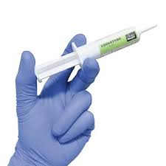
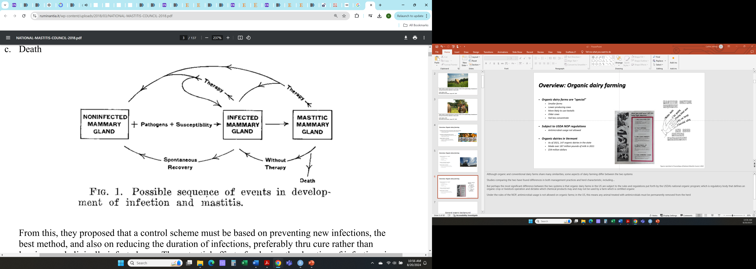


Overview: Udder health on organic dairies
Antimicrobial usage on dairies
Primary reason for AMR usage on dairies is mastitis/intramammary infections
Important component of udder health programs
X
X
X
X
Figures reprinted in Proceedings of National Mastitis Council, 2018
Notes:
The primary reason for antimicrobial drug usage in adult dairy cows in the US is for treatment of mastitis, which is inflammation of the mammary gland, most commonly caused by a bacterial infection. (Pol and Ruegg, 2007b)
Traditionally, intramammary antimicrobial usage has been (and still is) an important component of udder health programs, as demonstrated by considering the classic 5 point plan put forth to control mastitis by the Milk Marketing Board of England and Wales in 1971.
This plan has become more detailed and nuanced over time, but as you can see from these materials distributed back then to farmers, 2 of the 5 points consisted of treating cows with intramammary antimicrobials (treatment of clinical cases and dry cow therapy). Although it’s an oversimplification, this visual demonstrates that without being able to use antimicrobials, organic dairy farms are left with limited available options to effectively treat and control mastitis
Additionally, although the reality is more nuanced, this classic, but rather overly dramatic diagram, illustrates how the inability to treat mastitis could potentially result in worse overall udder health on organic vs. conventional dairies. Here we see our mammary gland becomes infected, progresses to diseased, and then has three potential outcomes: therapy with antimicrobials to return to a healthy state, or spontaneous recovery without treatment, or death.
J Eric Hillerton; James Booth
Dodd, F.H., F.K. Neave, and R.G. Kingwill. 1964. Control of udder infection by management. J. Dairy Sci. 47:1109-1114.
Five-point plan, Veterinary Research Unit led by James Booth of the Milk Marketing Board of England and Wales (MMB) 1971
New Zealand Ministry of Agriculture and Fisheries leaflet, Milking Management, 1974
(Zwald et al., 2004)
Stiglbauer et al., 2013
USDA. 2024. USDA Organic Regulations. Accessed June 7, 2024. https://www.ecfr.gov/current/title-7/subtitle-B/chapter-I/subchapter-M/part-205?toc=1

Slide 54

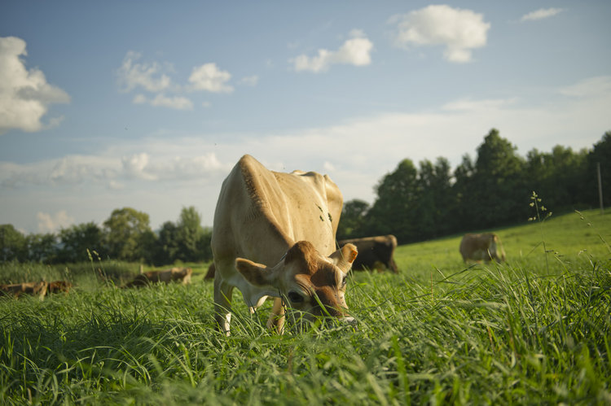
Methods: Study overview
Organicvalley.coop
Photo: M. Webb
Inclusion criteria for herds:
Certified organic dairy
Milking between 35 and 120 cows
Utilizing a tiestall with shavings OR a bedded pack system
Notes:
Enrolled farms were a non-probability subsample of certified organic dairies in Vermont which had participated in previous studies. Other inclusion criteria were that farms: 1) milked between 35-120 cows and 2) used either a tiestall barn bedded with shavings or a bedded pack system to house lactating dairy cows, FOR their WINTER HOUSING system, as most of these herds are primarily pasture-based during the grazing season

Slide 55
Directions for future research
Short-term projects
Further work exploring antimicrobial resistance for S. chromogenes isolates
Concordance between blaZ and penicillin resistance
Where is blaZ carried?
Bigger picture projects
Antimicrobial resistance in organic dairy systems
Comparison of AMR carriage in staphylococci from the same farm over the long-term
Notes:
As I think everyone in research feels after completing a project, this work has brought to mind a lot of directions for future research and more questions to answer.
One of the smaller, short-term projects identified would be further exploration of the antimicrobial resistance profile of S. chromogenes isolates which underwent whole genome sequencing. A fairly high proportion were positive for the gene encoding blaZ, but carriage of a particular resistance gene does not always translate into phenotypic resistance. It would be interesting to explore the concordance between phenotypic and genotypic resistance results for these isolates. Twelve of the 30 isolates from this project underwent phenotypic susceptibility testing for penicillin for a different study, with 100% agreement between blaZ carriage status and susceptibility. 4 out of 4 isolates positive for blaZ were penicillin resistant, while 8 isolates negative for blaZ were penicillin susceptible.
A related question would be identifying whether the blaZ gene is located on a part of a genetic mobile element (usually a plasmid) or chromosomally for these isolates. Location of blaZ carriage is not well characterized for Staph. chromogenes originating from bovine IMI. Preliminary work exploring location of blaZ gene for the 10 positive isolates in the current study found that 4 were negative for plasmid carriage. When resistance genes are harbored on horizontally transmissible elements (such as plasmids), strains carrying these elements can successfully disseminate them to new, previously-susceptible bacteria, belonging to both the same species and different species. Location of resistance determinants on plasmids generally promotes more efficient spread of resistance genes. Studies exploring whether blaZ is more likely to be carried chromosomally or on a plasmid for Staph. chromogenes from bovine IMI would be useful in understanding transmission of penicillin resistance for this predominant mastitis pathogen.
----
Lastly, staphylococci causing IMI from a particular farm enrolled in the current study were collected and stored from a previous study, approximately 25 years earlier. This farm was founded in the 1970s and has no history of antibiotic use. It would be interesting to compare the species-specific AMR profile for staphylococci over time for this farm. A study like this could help us start to understand where resistance genes in bacteria from organic farms came from, how long they maintain them in the absence of selective antimicrobial pressure, and specifically what types of resistance are maintained. Improving our understanding of how AMR is transmitted or retained in dairy farm systems is essential for developing effective strategies to mitigate resistance among mastitis pathogens.
----
Lastly, an extremely unique opportunity exists for research using IMI isolates from this project. Staphylococci causing IMI from a particular farm enrolled in the current study were collected and stored from a previous study, approximately 25 years earlier. This particular farm was founded in the 1970s and has no history of antibiotic use. Has the same type of penicillin resistance has been maintained in staphylococci for this farm, or have ARG’s conferring penicillin resistance shifted over time? Furthermore, identifying where any ARG present in both new and old isolates are carried in the genome could help us determine why they have been maintained. A study like this could help us start to understand where resistance genes in bacteria from organic farms came from, how long they maintain them in the absence of selective antimicrobial pressure, and specifically what types of resistance are maintained. Improving our understanding of how AMR is transmitted or retained in dairy farm systems is essential for developing effective strategies to mitigate resistance among mastitis pathogens.

Slide 56
Conclusions: Study 3
Strain type, ARG carriage, or number of VF did not predict SCC status
Strain type appears to predict blaZ carriage, VF presence and distribution
Penicillin resistance common in mastitis isolates from organic farms
Identification of two notable virulence factors
Staphylocoagulase, exfoliative toxin C
Notes:
Moving on to some selected conclusions from this study:
Strain type, ARG carriage, and cumulative number of VF were not found to be a significant predictor of whether an isolate would be in the HIGH or LOW SCC IMI category.
However, Strain type appears to predict blaZ carriage, VF presence and distribution
Carriage of blaZ, encoding Penicillin resistance, was common in these mastitis isolates from organic farms, despite absence of selective antimicrobial pressure
Lastly, two virulence factors were found which have not yet been widely reported to be present in isolates of staph chromogenes from bovine IMI, which were
staphylocoagulase, exfoliative toxin c
----
~36 minutes?
2 ST25 from same farm
2 ST 48 from 2 different farms
ST6 from 5 farms
ST5 from 2 farms
ST1 from 2 farms

Slide 57
Directions for future research
Further work exploring antimicrobial resistance for S. chromogenes
Concordance between blaZ and penicillin resistance
Where is blaZ carried?
Notes:
This work has brought to mind a lot of directions for future research and more questions to answer.
A fairly high proportion of isolates were positive for the blaZ gene, but carriage of a particular resistance gene does not always translate into phenotypic resistance. It would be interesting to explore the concordance between phenotypic and genotypic resistance results for these isolates. Twelve of the 30 isolates from this project underwent phenotypic susceptibility testing for penicillin for a different study, with 100% agreement between blaZ carriage status and susceptibility. 4 out of 4 isolates positive for blaZ were penicillin resistant, while 8 isolates negative for blaZ were penicillin susceptible.
A related question would be identifying whether the blaZ gene is located on a mobile genetic element (usually a plasmid) or chromosomally for these isolates. Location of blaZ carriage is not well characterized for Staph. chromogenes originating from bovine IMI. Some preliminary work has shown that out of the 10 blaZ positive isolates in the current study, 4 were negative for plasmid carriage. Resistance genes located on mobile genetic elements are more efficiently transmitted through populations of bacteria, so location of the gene would have ramifications for the transmission of penicillin resistance among staphylococci causing IMI on dairy farms.

Slide 58
General conclusions and overall significance
Non-aureus staphylococci are important mastitis pathogens
Predominant pathogen group causing IMI on farms
Eight out of nine species elevate qSCC -> increased BTSCC
S. chromogenes in particular
33% prevalence of penicillin resistance in isolates from organic farms
Extremely persistent, wide-spread intramammary pathogen
Reliably increases qSCC
May act in a contagious manner
Deeper understanding of intraspecies diversity of S. chromogenes
Identification of MLST types causing persistent IMI, 4 novel ST
Description of AMR and virulence pattern
AMR and virulence likely determined by strain type
Notes:
Although I’m certainly not the first or last researcher to say as much, this work underscores that non-aureus staphylococci are indeed worthy of consideration as significant mastitis pathogens, and are not “minor” mastitis pathogens as some have previously described them. NASM were the predominant pathogen causing IMI in these herds, with Eight of the nine NAS species elevating SCC above that of no growth quarters. Although this increase was modest for most species observed, their widespread nature can still result in an increased bulk tank SCC.
This work underscores the importance of Staph. chromogenes specifically as a mastitis pathogen. We found 33% of isolates causing persistent IMI carry the gene for penicillin resistance, which is especially noteworthy as these isolates originate from organic farms. Findings from our longitudinal study demonstrate that chromogenes has a great ability to persist in the mammary gland, as well as cause a number of infections associated with a persistently high SCC. Furthermore, findings from this work also suggest that particular strains may behave in a contagious manner within a herd.
This work contributes to the understanding of intraspecies diversity within Staph. chromogenes. 10 ST were identified to be causing 30 persistent IMI, including four novel ST. The AMR and virulence profile for 30 Staph. chromogenes were described from whole genome sequence data. Although no association was found between ST, virulence and AMR carriage and whether or not the associated persistent IMI would have a high or low SCC, findings seem to indicate a genetic basis for virulence and AMR carriage in Staph. chromogenes.
---
Taken together, this research generated foundational knowledge about the epidemiology of staphylococci causing mastitis on organic dairy farms in Vermont. While all dairy producers rely on best management practices to support cow health, mastitis control is of the utmost importance in the prevention of IMI on organic farms. Better understanding the epidemiology of mastitis pathogens leads to more effective measures which prevent or limit transmission of IMI. Mitigating the effect of mastitis caused by staphylococci through more effective, targeted prevention and control measures helps dairy producers achieve quality price premiums and results in a higher-quality product for consumers.
``````````````
~43 minutes?

